Slide 1
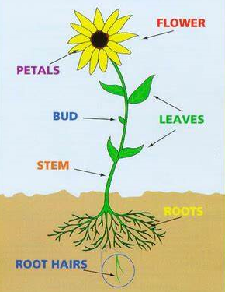
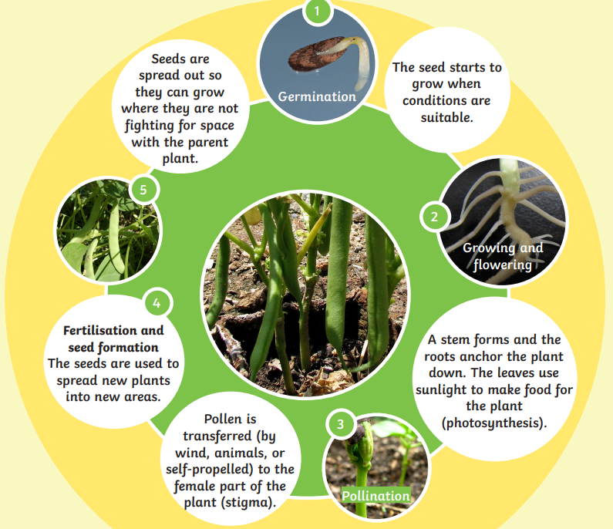
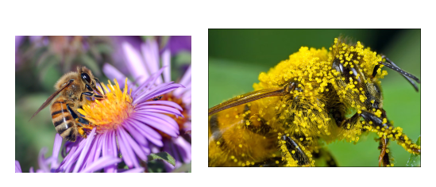


Shirley Heath Plants | Year 3 | Autumn 1
Key Knowledge
In order to grow a plant needs light, water, room to grow, nutrients from soil and sir.
Adaptation is how plants may live in places that aren’t perfect. A cactus grows with barely any water in the desert.
The process of water transportation is the way water moves through a plant. The roots absorb water from the soil. The stem transports water to the leaves. Water evaporates from the leaves.
Seeds can dispersed by: the wind, water, rolling, exploding, attaching themselves to animals.
Most plants are pollinated by animals or wind. Honey Bees carry out more pollination than any other insect, which includes ants, beetles, butterflies and moths.
Key Vocabulary
1 | Root | Supports the plant and takes in water and nutrients
2 | Stem | Supports the leaves and transports water and nutrients
3 | Leaves | Uses water and carbon dioxide to make food for the plant (photosynthesis)
4 | Flowers | Usually bright to attract insects for pollination
5 | Germination | The sprouting of a seedling (young plant) from a seed
6 | Growth | An increase in the size of the plant as it grows
7 | Flowering | The production of flowers by the plant so that insects can be attracted
8 | Pollination | Pollen from one plant being taken to a different plant so that a seed can form
9 | Seed formation (fertilisation) | The last stage of a plant’s reproduction from which a new plant can grow
10 | Seed dispersal | Seeds are spread over a large area so new plants can grow in different places

