Slide 1
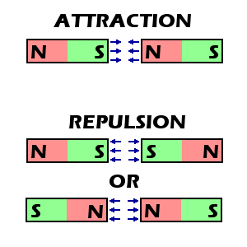
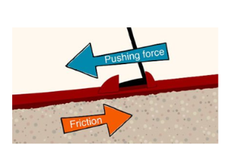
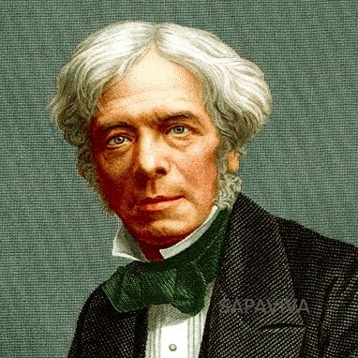
Shirley Heath Physics (Forces and Magnets) | Year 3 | Autumn 2
Key Knowledge
1 | Most forces require contact between two objects (pushing, pulling, twisting and stretching forces).
2 | Magnetic forces can act at a distance without contact between two objects.
3 | Opposite poles (north and south) attract each other
4 | The same poles (north and north), (south and south) repel each other
5 | Magnetic materials contain the metals iron, nickel or colbalt
Key Diagrams
Key Vocabulary
1 | Force | A force is a push, pull, twist or stretch
2 | Newton | Force is measured in Newtons
3 | Newton meter | This is the device used to measure force in Newtons
4 | Magnetic material | Objects that will be attracted to a magnet
5 | Non-magnetic material | Objects that will not be attracted to a magnet
6 | Attraction | When the north and south poles of a magnet are placed together
7 | Repulsion | When the same pole (N-N or S-S) are placed together
8 | Friction | The force created when two objects rub together
Magnets
Important Scientist
1 | Michael Faraday (1791- 1867) | A very important British scientist that developed ideas around electromagnetism. He used magnets to create electricity for the first time.We still make electricity this way today.
Friction

