Slide 1
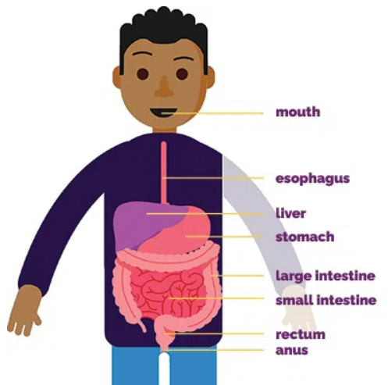
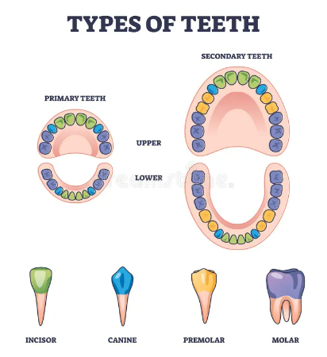
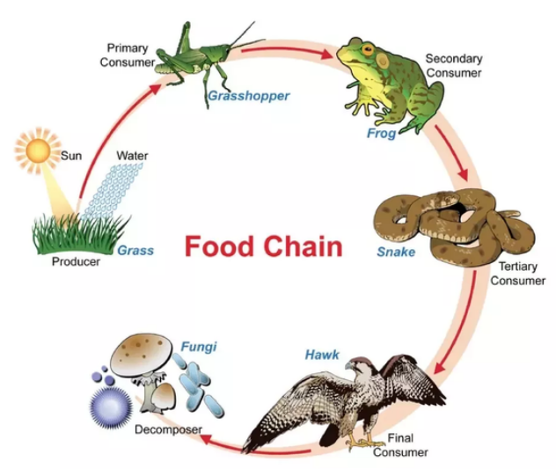
Shirley Heath Animals including humans | Year 4 | Autumn 1
Key Knowledge
Digestive system- a series of organs that break the food down so it can be absorbed into our bloodstream.
Incisors are for biting and cutting food. Canines are for ripping and tearing food. Premolars and molars are for holding, crushing and grinding food.
Tooth decay is the destruction of your tooth enamel which is the hard, outer layer of your teeth. Plaque is a sticky film of bacteria which constantly forms on your teeth. When you eat and drink foods containing sugars, the bacteria in the plaque produce acids that start to break down tooth enamel.
Key Diagrams
Key Vocabulary
1 | Mouth | Where food is taken into the mouth and chewed by teeth
2 | Oesophagus | A tough muscular tube connecting the mouth and the stomach
3 | Stomach | Churns and breaks down food further so that it can be digested properly
4 | Small Intestine | Most of the nutrients are absorbed from your food
5 | Large Intestine | Stools are prepared, water absorbed into body
6 | Rectum | Where stools are stored before leaving the body
7 | Anus | The passage from where stools leave the body
Key Vocabulary
1 | Food chain | A sequence showing the links between living things and what they eat
2 | producer | An organism that produces its own food eg: a plant
3 | consumer | animals that eat other plants or animals
4 | prey | Is eaten by other animals
5 | Predator | Eats other animals

