Slide 1
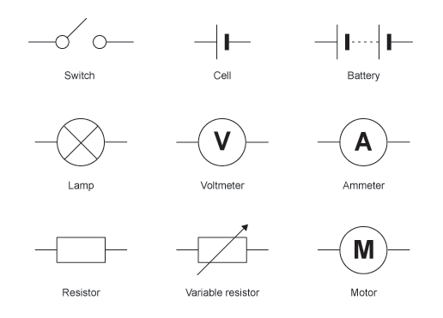
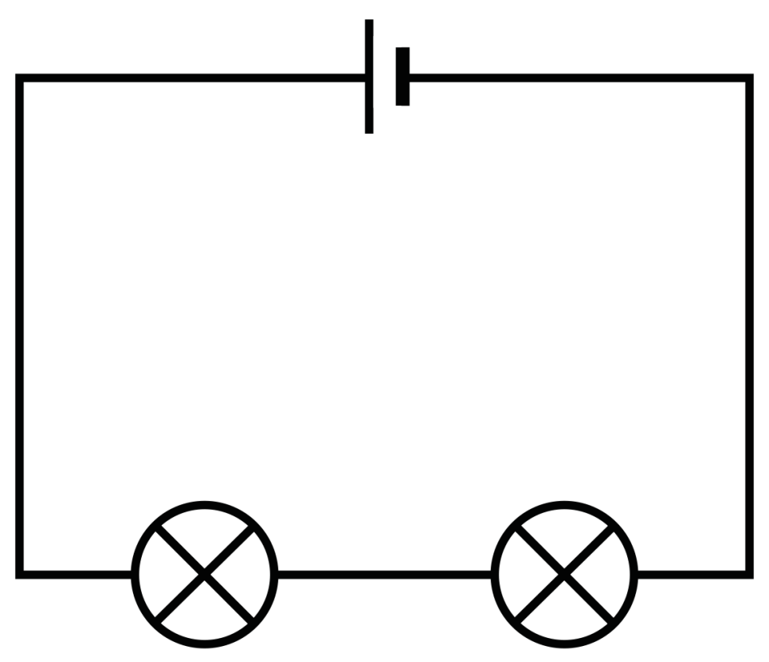
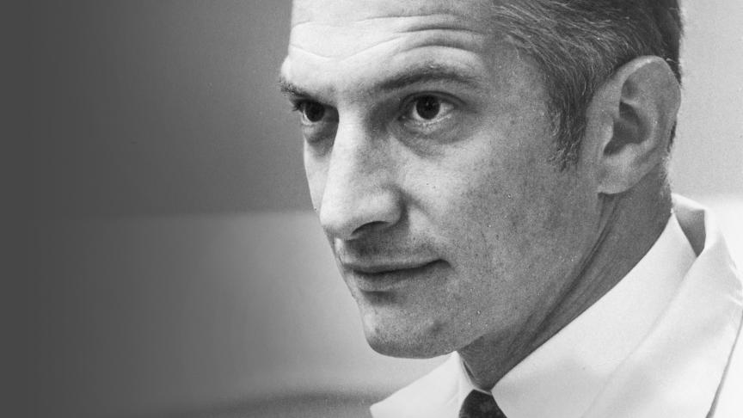
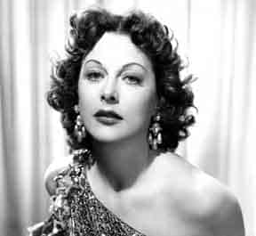
Shirley Heath Physics (Electricity) | Year 4 | Autumn 2
Key Knowledge
1 | Electricity is a major part of everyday life. It is made in lots of different ways.
2 | Electricity can be made from burning fossil fuels (coal, oil, gas) or it can be made from renewable energy (solar, wind, wave power etc)
3 | A circuit will only work if there are no breaks in the circuit and the electricity can flow all of the way around.
Key Diagrams
Key Vocabulary
1 | Current | The word we use to describe how quickly the electricity is moving around the circuit.
2 | Voltage | The pushing force which pushes electricity around the circuit from the cell/battery
3 | Series circuit | A loop of wire containing at least a cell and other components
4 | Conductors | Allow the flow of electricity (usually metals)
5 | Insulators | Prevent the flow of electricity. Used to protect us from electric shocks
6 | Cell | This is what we normally refer to as a ‘battery’. It is one cell.
7 | Battery | A battery is when two or more cells are used together.
8 | Lamp | Used to turn electrical energy into light and heat energy.
Components of a circuit
Simple series circuit
Important Scientists
1 | Robert Noyce (1927-1990) | Co-invented the silicon chip which is in all computers
2 | Hedy Lamarr (1913-2000) | A movie star who also developed World War II communication technology

