Slide 1
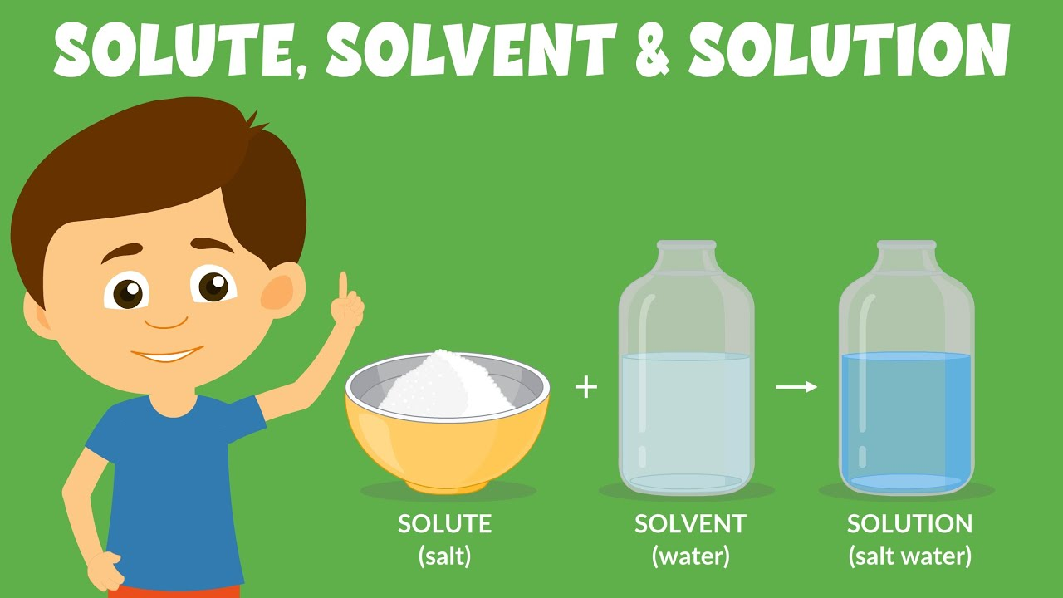
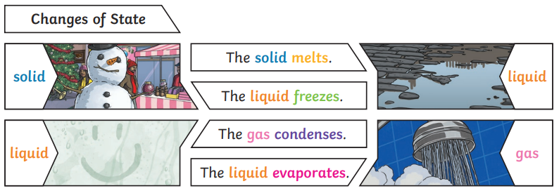
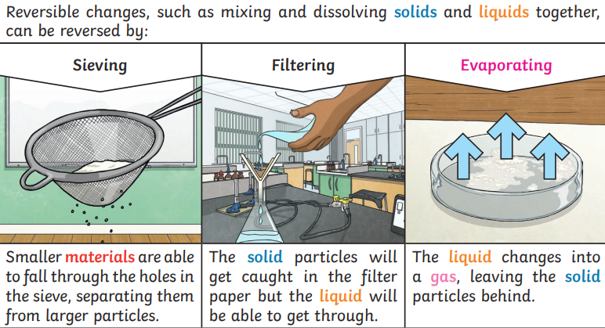
Shirley Heath Properties and Changes of Materials| Year 5 | Autumn 1
Key Knowledge
1 | Materials are objects that look, feel and behave differently from one another.
2 | Materials can be tested for their different physical properties. These could include: hardness, solubility in water, electrical conductivity, flexibility, magnetism, etc.
3 | Some substances dissolve really well in water and other substances do not dissolve well in water.
4 | There are different ways to speed up the process of dissolving.
5 | Mixtures can be separated in different ways. This depends on the size of the particles or the way the substances are mixed.
Key Vocabulary
1 | soluble | A material which is capable of being dissolved eg: sugar
2 | insoluble | A material which is not capable of being dissolved eg: sand
3 | solvent | A liquid which can dissolve another substance
4 | solute | The substance which is being dissolved in a solvent
5 | solution | A mixture of the solvent and solute
6 | dissolving | A solution is made when solid particles are mixed with liquid particles
7 | melting | The process of heating a solid until it changes into a liquid
8 | evaporating | When a liquid turns into a gas. It can be used to separate materials
9 | conductor | a material that heat or electricity can easily travel through
10 | Reversible | A process that can be reversed e.g. melting water
11 | irreversible | A process that cannot be reversed e.g. frying an egg
12 | filtering | Separating an insoluble substance from a liquid by using filter paper
13 | insulator | a material that does not let heat or electricity travel through them
14 | transparent | An object that lets light through, eg: glass

