Slide 1
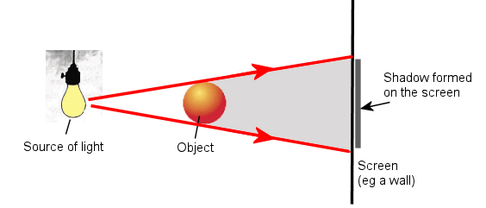
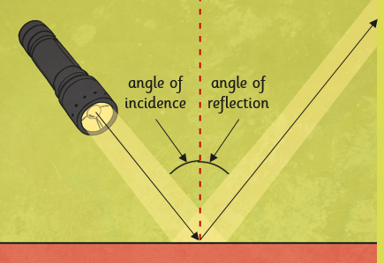
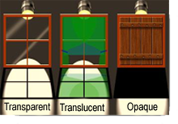
Shirley Heath Light| Year 6 | Autumn 1
Key Knowledge
1 | Light travels in straight lines.
2 | We are able to see using light when the light rays bounce off of an object and then the light enters our eyes.
3 | When rays of light reflect, they obey the law of reflection: the angle of incidence always equals the angle of reflection.
4 | Mirrors can be used to see objects which are not immediately in our field of view. If the mirrors are arranged correctly then we can enable someone to see an object in any position.
5 | Visible light is made up of the 7 colours of the rainbow.
6 | Shadows are the same shape as the object that made them.
7 | Rays of light change direction and bend when they go through other transparent materials, such as water.
Key Diagrams
Key Vocabulary
1 | Light source | Where the light is being produced
2 | Reflector | Something that light bounces off as it travels in straight lines
3 | Light energy | The type of energy carried by light
4 | Shadow | Where light cannot reach
5 | Opaque | Light cannot pass through
6 | Transparent | Light can pass through
7 | Translucent | Light can partially pass through
8 | incidence ray | Ray of light that hits an object
9 | reflected ray | Ray of light that bounces off an object
11 | refraction | Light changing direction and bending
12 | spectrum | The colours of the spectrum are violet (V), indigo (1), blue (B), green (G), yellow (Y), orange (O), and red (R).

