Slide 1
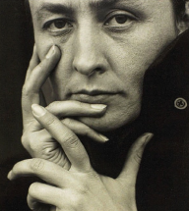
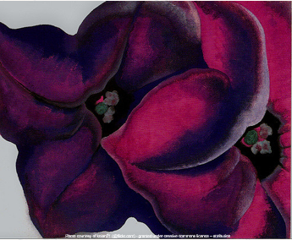
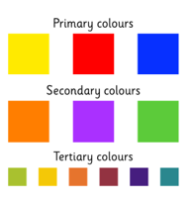
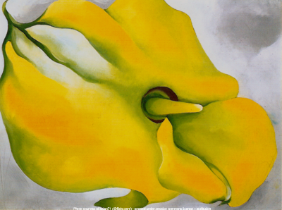
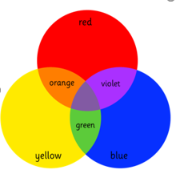
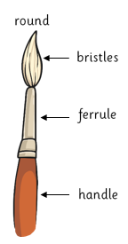
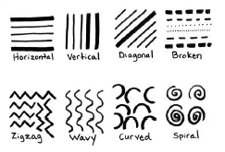
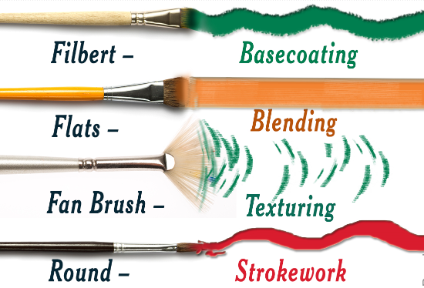
Shirley Heath Painting: Georgia O’Keefe | Year 3 | Term: Autumn
Georgia O’Keefe
Elements of Art: Colour
Vocabulary
1 | Primary colours (red, yellow, blue) | Three colours of the spectrum from which all other colours can be made by mixing.
2 | Secondary colours (green, purple, orange) | A colour achieved from the mixing of two primary colours.
3 | Tertiary colours | When an equal amount of a primary and a secondary colour are mixed.
4 | Texture | The feel or look of a surface.
5 | Colour blocking | Taking colours that are opposites on the colour wheel and pairing them together to make interesting combinations.
6 | Colour washes | A thin coat of water-base paint.
7 | Monochrome | Black and white or varying tones of only one colour.
Who is she and what is she famous for?
She was an American artist, born in 1887. She painted nature in a way that showed how it made her feel. She is best known for her paintings of flowers and desert landscapes. Her style of art is known as American Modernisim.
What inspired her?
The simplified shapes of the landscapes and a fascination of the bones and skulls of animals she found in the desert.
Paints
Elements of art: line
There are four types of paint
Acrylic: dries fast, when dry can be painted over, water resistant, covers most surfaces
Water colours: if paint dries water can be added to make it reusable, colours dry lighter, no white – use the paper instead, cheap paints
Powder paints: wide selection of colours, thickness depends on how much water is added.
Oils: dries very slowly, when dry can be painted over, colours remain bright when dried, can be used thickly or thinly, large range of colours.

