Slide 1
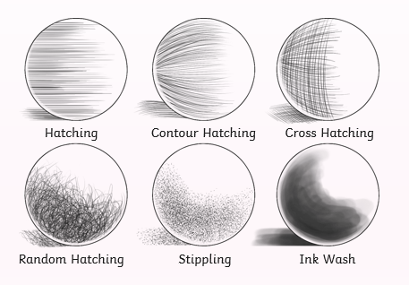
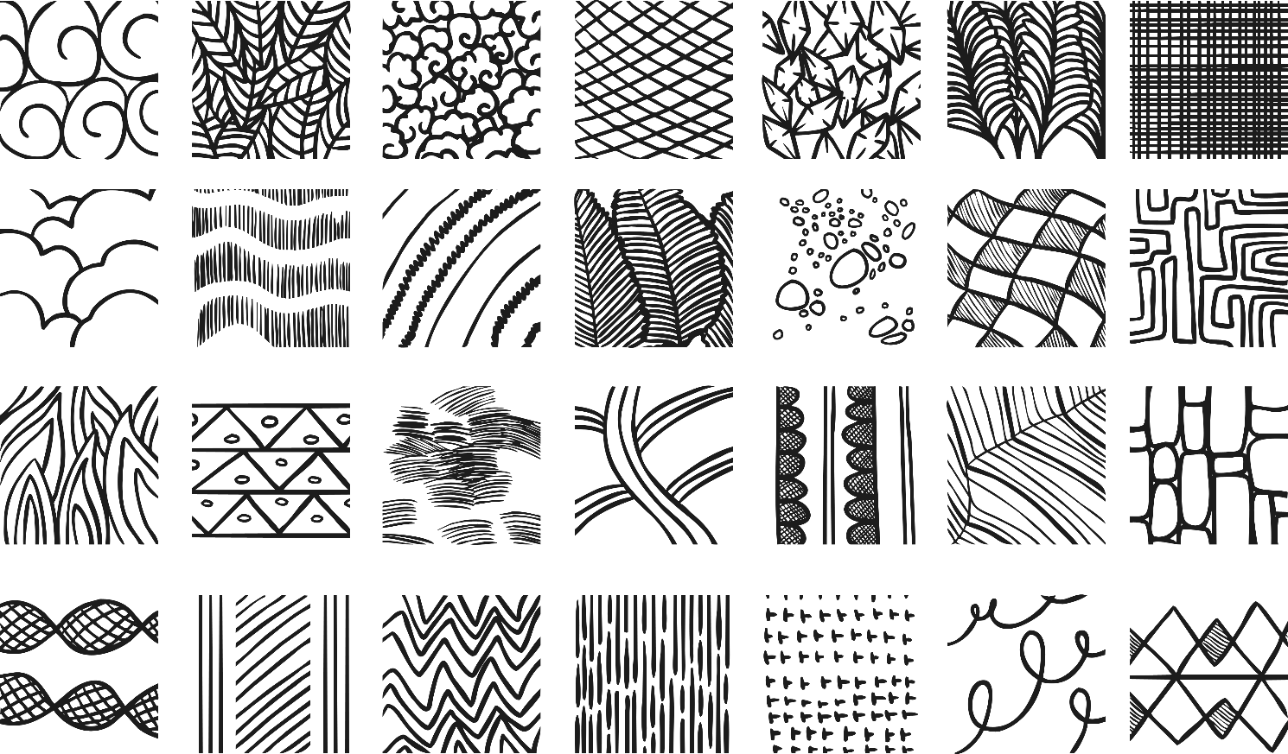
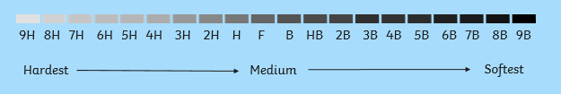
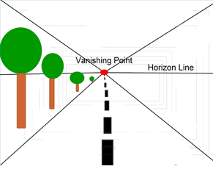
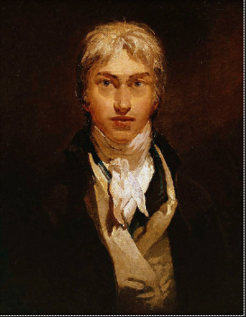
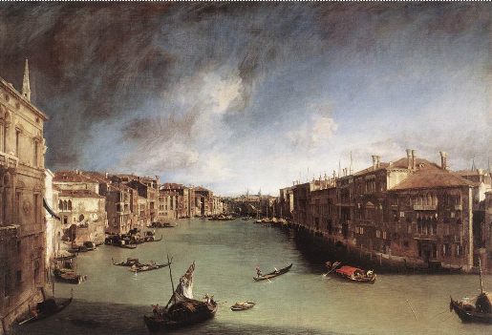
Shirley Heath Drawing: Landscapes in perspectives | Year 4 | Term: Autumn
Drawing texture using line and shape
Vocabulary
1 | Texture | The feeling, appearance or consistency of an object or material.
2 | Line | Lines are used by artists and designers to describe objects, add detail or create expression. Lines define an artwork and reveal the artist’s techniques.
3 | Tone | Tone is the relative lightness or darkness of a color.
4 | Shading | Shading is used in drawing for showing levels of darkness on paper by applying media more densely or with a darker shade for darker areas, and less densely or with a lighter shade for lighter areas.
5 | Blend | It is the technique of gently mixing two or more colours or values to create a gradual change or to soften lines.
6 | Perspective | A way of showing space, depth and perspective in a picture.
7 | Vanishing point | It is the point in a perspective drawing where lines that either parallel to each other or are not parallel to the main subject of the painting come together.
8 | Horizon | A horizontal line that runs across the paper or canvas to represent the viewer's eye level, or show where the sky meets the ground. It should rarely be in the center of the composition, but ideally placed about one-third of the way up or down the piece.
Texture can be natural or man-made, functional or decorative. Artists try to replicate the texture of the subject to make their work look as realistic as possible.
HB Graphite Scale
The degree of hardness of a pencil is printed on the pencil. The degrees of hardness of pencils are roughly divided into four groups: B stands for "black". These pencils are soft. H stands for "hard". HB stands for "hard black", which means "medium hard". F stands for "firm".
Turner
Turner is called “the painter of light” due to his mastery in capturing the effects of atmosphere and light.

