Slide 1
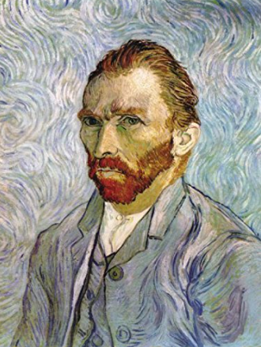
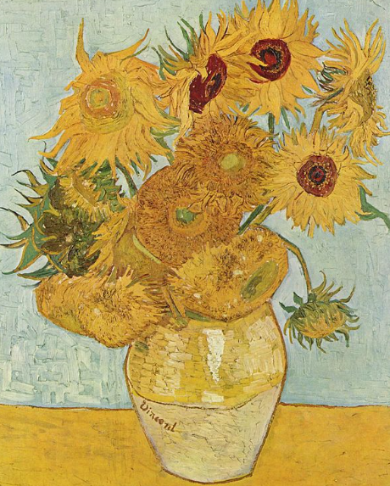
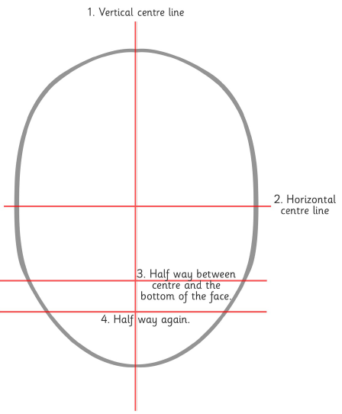
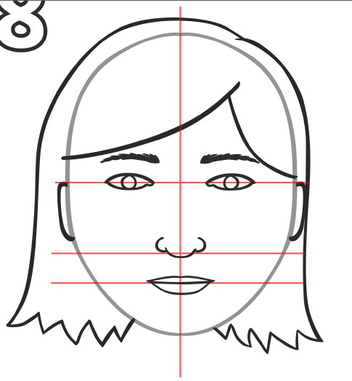
Shirley Heath Drawings - Portraits| Year 5 | Autumn Term
Vincent van Gogh
Vocabulary
1 | Still life | The small objects, such as fruit, flowers, and bottles, that are used as subjects for a painting or photograph.
2 | Composition | The relation among the parts of something; order or structure. It means ‘putting together’.
3 | Contrast | Refers to the arrangement of opposite elements (light vs. dark colours, rough vs. smooth textures, large vs. small shapes, etc.) in a piece so as to create visual interest, excitement and drama.
4 | Foreground | The part of something, such as a painting or photo, that is or appears to be nearest the viewer
5 | Background | A part located in the rear, esp. as depicted in a painting, photograph, or scene
6 | Focal point | This is the area in the composition to which the viewer's eye is naturally drawn.
7 | Proportion | The proper relationship between things or parts with respect to size or amount.
8 | Mood | This is the atmosphere in a painting, or the feeling expressed eg: is the art tranquil, or is it dark and disturbing?
9 | Point of view | Refers to the place or physical position from which the artist or viewer looks at a subject (e.g, eye-level or birds-eye view).
Who is he and what is he famous for?
He was a Dutch artist and painter, born 1853 - died 1890. Van Gogh was known for his thick application of paint on canvas, called impasto. An Italian word for “paste” or “mixture”, impasto is used to describe a painting technique where paint (usually oil) is laid on so thickly that the texture of brush strokes or palette knife are clearly visible.
What inspired him?
He was born in the Netherlands, but travelled across Europe to France, Belgium and England. He was inspired by other painters who were painting everyday life. He liked to paint nature and the places he had visited.
Facial proportions
The sides of the skull are the widest parts of the head.
The head tapers from the sides of the skull to the cheekbones, then the jaw, then the chin.
Guidelines help to keep the features symmetrical on both sides of the face and level across the face (following the eye line).
The features that make the focal point of the face form a T shape in the centre of the face.
The eye is drawn to these features (eyebrows, eyes, bridge of the nose and nose.)

