Slide 1
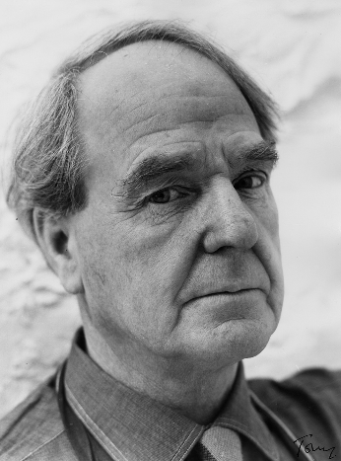
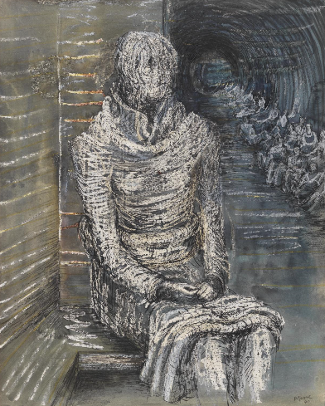
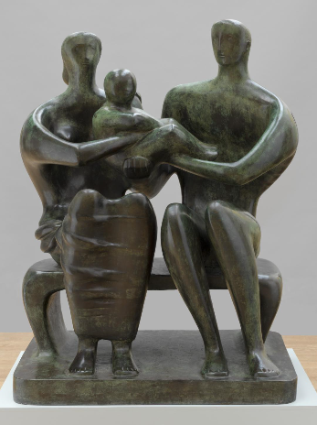

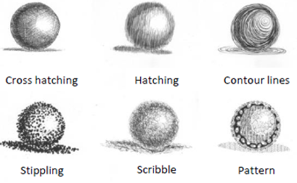
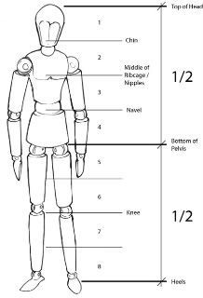
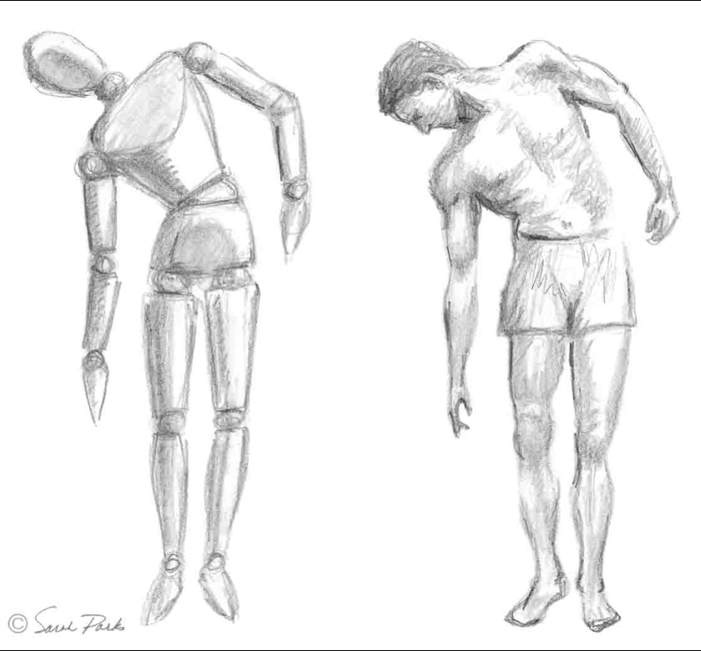
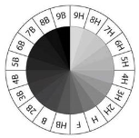
Shirley Heath Drawing: | Year 6 | Term: Autumn
Henry Moore
Elements of Art: tonal shade
Vocabulary
1 | Balance | This refers to how the elements of art (line, shape, colour, value, space, form, texture) relate to each other within the composition. That is, one sides visual weight does not seem heavier than another.
2 | Visual movement | The impression of action/movement in a work of art.
3 | Viewpoint | Describes the position of the subject to the viewer.
4 | Perspective | This refers to the perceived depth in art.
5 | Value | Describes the relative lightness and darkness of colours in a composition. White is the highest value and pure black the lowest.
6 | Tone | Tone is the degree of intensity or strength of a colour. A pure lemon yellow has a high tone, while browns have low tones.
Produce a range of tones by varying the pressure and layering – consider using softer pencils for darker shades
Alternative shading techniques
Who is he and what is he famous for?
He was an English artist and sculpture, born 1897 - died 1986. Moore is famous for his sculptures of people with bumpy forms and hollow spaces in their bodies as well as flowing abstract shapes. During World War II, he was commissioned by the War Artists Advisory Committee to make drawings of people in London using underground stations as bomb shelters. The scratchy dark drawings powerfully capture the feelings of anxiety that people must have felt.
What inspired him?
Henry Moore was a teacher and was in the army before going to Leeds School of Art to learn to become a sculptor. He was inspired by nature. He sketched the hills near where he grew up and collected interesting stones, animal bones and tree roots on his regular walks in the countryside. He used these bumpy, twisted natural forms to inspire his sculptures. Can you see the inspiration of nature in his sculptures?
Body proportions
Pencil tonal values

