Slide 1
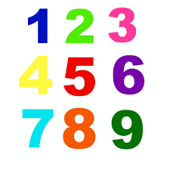
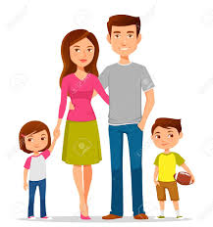
Shirley Heath Moi | Year 3| Autumn 1
Vocabulary – basic greetings
Bonjour! | Hello!
Salut! | Hi!/Bye!
Ça va? | How are you?
Ça va bien | I’m fine
Ça va mal | I’m not very well
Et toi? | And you?
Au revoir! | Goodbye!
Monsieur/ Madame | Mr/Sir Mrs/Miss
Oui non | Yes no
Je m’appelle….. | My name is ...
Comment tu t’appelles? | What’s your name?
voici ... | here is ...
Vocabulary –numbers and age
1 une | 6 six
2 deux | 7 sept
3 trois | 8 huit
4 quatre | 9 neuf
5 cinq | 10 dix
J’ai ... | I have ...
Quel âge as-tu? | How old are you?
J’ai sept/huit ans. | I’m seven/eight years old.
Vocabulary – family members
mon père | my father
ma mère | my mother
mon frère | my brother
ma sœur | my sister
Phonics Focus:
Rolling your ‘r’
mere, bonjour

