Slide 1
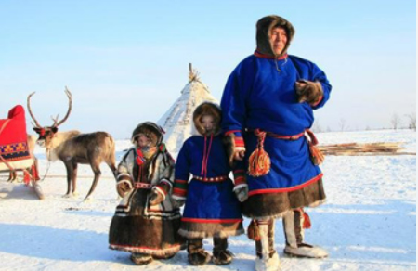

Shirley Heath Why is the Arctic Changing? | Year 5 | Autumn 2
THE ARCTIC CIRCLE
LOCATION | The Arctic is in the Northern Hemisphere at the North Pole
COUNTRIES | Canada, Greenland, Iceland, Norway, Sweden, Finland, Russia
SUMMER | The sun never sets, the ice and snow melt, showing the land underneath.
WINTER | Long, dark nights that last for months the land is covered in snow and ice.
BIOMES | The Arctic is a tundra biome.
CLIMATE | Summer average: 10 °C Winter average: -34° C
VOCABULARY
Hemisphere | one of the halves of the earth as divided by the equator
Biome | A biome is a distinct geographical region with specific climate, vegetation, and animal life.
Vegetation | Plants found in a particular area or habitat.
Glacier | Ice and snow that flows over land
Ecosystem | An ecosystem is a community of living organisms (plants, animals and microbes) in a particular area.
Indigenous | Member of any of the original peoples living in an area
Fossil fuels | A natural fuel such as coal or gas
Climate change | The shift in the Earth’s usual weather conditions over many years
Global warming | Earth has been getting hotter
Renewable energy | An energy source such as wind or solar power that isn’t depleted when used
Greenhouse effect | The small amounts of greenhouse gases in the Earth's atmosphere have increased. Like a greenhouse, they trap heat in our atmosphere.
IMPACT OF GLOBAL WARMING
Rising sea levels
Severe weather events
Loss of animal habitats
Loss of fish/birds
SVALBARD
Svalbard is a between the mainland of Norway and the North Pole.
People travel here to see the Northern Lights
Svalbard follow sustainable tourism
ARCTIC | ANTARCTICA
Northern Hemisphere | Southern Hemisphere
An ocean, covered by a thin layer of perennial sea ice and surrounded by land. | A continent, covered by a very thick ice cap and surrounded by a rim of sea ice and the Southern Ocean.
Animals include polar bears, lemmings and narwhals. | Animals include penguins, elephant seals and the wandering albatross.
Home to a range of native people, such as Inuit, | No people permanently live here.
INUIIT LIFE
Indigenous people of the Arctic and subarctic regions of North America.
Jobs | Hunting, fishing, and gathering, relying on the land and sea
Food | Traditional Inuit foods include arctic char, seal, polar bear and caribou
Values | Traditional values such as sharing of food, respect for others and cooperation

