Slide 1
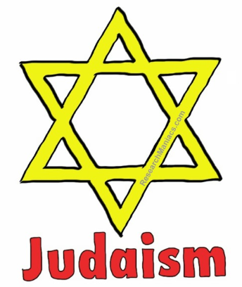

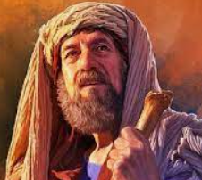
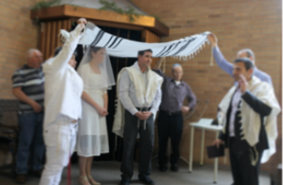
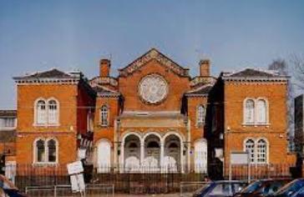
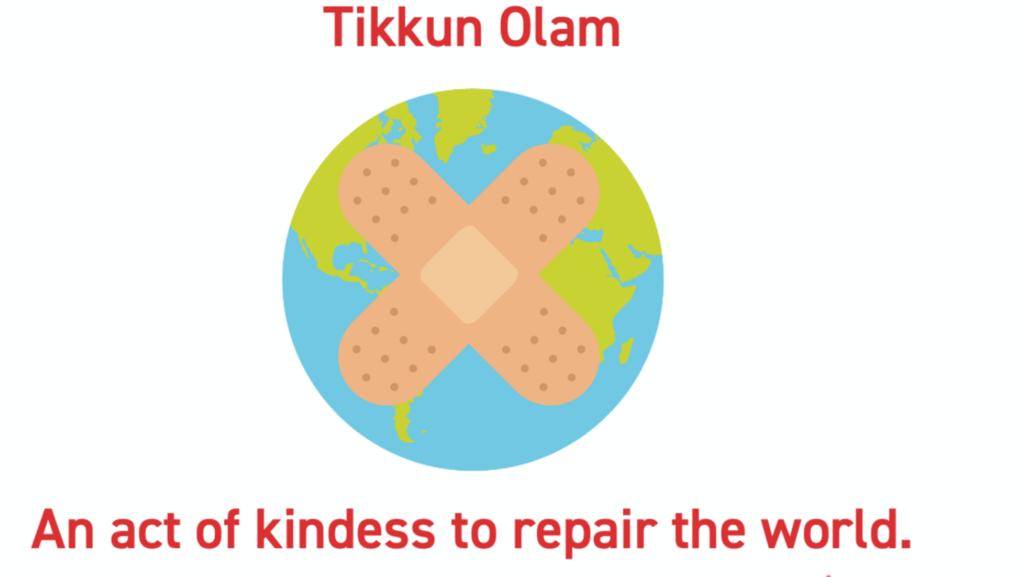
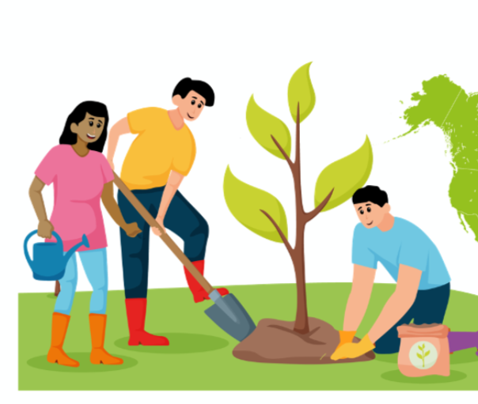
Year 4 Autumn 1 Judaism | What is the best way for a Jew to lead a good life?
Knowledge
Abraham is the founder of Judaism and he made a covenant with God
Jewish marriage: This is seen as a public commitment making ceremony and therefore a sincere desire to lead a good life.
Mitzvoth means doing good and helping others. This is an important part of Jewish life. There are 613 rules or suggested ways this can be done.
Mitzvah Day: Jews feel they can all make a positive difference to the world in which they live by giving their most valuable possession — their time.
Tikkun Olam (repair of the world) To perform an act of kindness that will improve or help to repair the world.
Tu B’Shevat: this is an annual tree planting ceremony which usually takes place in January or February. It is the Jewish New Year for trees. This is part of taking care of the environment.
Vocabulary
Agreement | When people think or feel the same way about something, they agree. It’s important to write this down or make a promise.
covenant | An agreement between people. In religion. An agreement is known as a covenant.
contract | An agreement made by 2 or more people.
Sacrifice | The act of giving up something of great value to show loyalty.
Wedding | A Jewish wedding is a seen as a public commitment making ceremony.
Ceremony | A formal act done to honour a special occasion.
commitment | A promise or firm decision to do something.
Torah | The Jewish holy book
Shabbat | Jewish day of rest.
Mitzvah day | Jews feel that they can make a positive difference to the world by giving away their most valuable possession.
Mitzvoth | Means doing good and helping others. An important part of Jewish life.
Torah scrolls
Abraham
Wedding Ceremony
Synagogue

