Slide 1
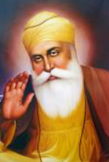
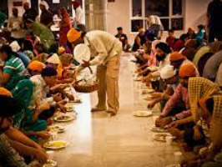
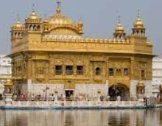
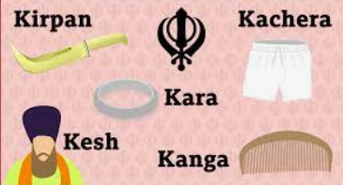
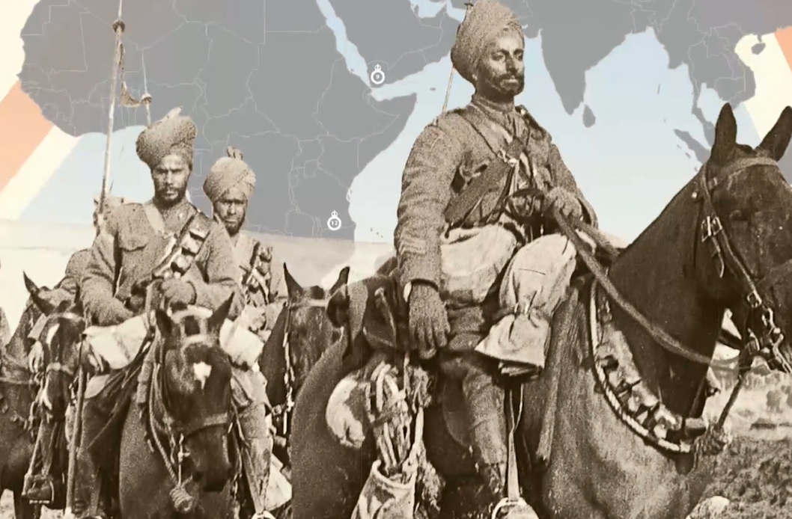
Shirley Heath How far would a Sikhi go for their religion? | Year 5 | Autumn 1
Langar
Knowledge
Naam Japo (Focus on God) Repeating God’s name through prayer and meditation.
Kirat Karni (honesty) To work hard and earn an honest living.
Vand Ke Chakna (sharing) Share what you have with others.
Sikhs should show their commitment to God by: believing that God is everything serving others treating everyone as equals sharing what they can earning an honest living.
A Kalsa Sikh is a very committed Sikh.
The Langar is the dining hall in the Gurdwara and the meal that is served in it. It is important to Sikhs because it symbolises that everyone is equal.
Vocabulary
Kalsa | It was formulated in 1699 by Guru Gobind Singh JI.
Golden Temple | A special holy place in Amritsar in India where Sihks visit.
Guru | A religious Teacher
Self sacrifice | Giving up something for the benefit of others.
Guru Granth Sahib | Sikh holy book.
The 5 K’s | The symbols of Sikhism worn by Sikhs. Khanga – comb Kesh – long hair Kara – Bangle Kashera – shorts Kirpan - sword
Gurdwara | Sikh place of worship: it means the doorway to the guru.
Commitment | An agreement or promise to do something in the future.
Equality | In Sikhism everyone is equal regardless of race, religion or gender. Everyone should be treated fairly and kindly
Sewa | Selfless service. Sikhis encourage people to help others through sharing and offering support and kindness.
Vaisakhi | The Sikhi Spring harvest festival.
Guru Nanak
founder of
Sikhism
Golden temple
The 5 K’s
Sikhs as soldiers during WW1 and WW2.

