Slide 1














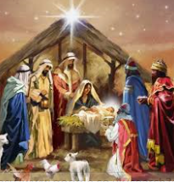
Year 3 Autumn 2 Christmas (Christianity) Has Christmas lost it’s true meaning?
Religious items
Knowledge
Christmas is a very important Christian festival because Christians are celebrating God’s son, Jesus, coming to earth to help people. It is celebrated on 25th December. Some objects at Christmas time are religious and some are non religious. The events of Christmas are told through the nativity story which can be found in the bible.
Vocabulary
Festival | A gathering of people to celebrate something.
Celebration | People do something special for an important event.
Advent | The time beginning on the 4th Sunday before Christmas
Nativity | The story of the birth of Jesus Christ.
Bible | Christian’s holy book.
Jesus | The name of the man who Christians believe was the son of God.
Church | Christian place of worship.
Mary | Mother of Jesus.
Joseph | Mary’s husband (Jesus’s father on earth)
Incarnation | God becoming man or literally being “made flesh”.
Non-religious items
Nativity Story
God chose a Jewish young woman called Mary, who was engaged to Joseph the carpenter, to be the mother of his earthly son. He sent his angel, Gabriel, to ask Mary to have the son of God. Mary agreed to allow this to happen and Jesus was born in Bethlehem. He was born in a stable and was visited by Shepherds. Wise men also visited him taking Gold - a precious metal, Frankincense – a sticky substance used in oils, Myrrh – a type of oil.
Nativity scene

