Slide 1
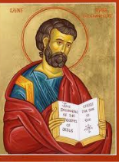
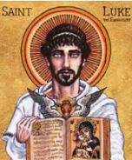
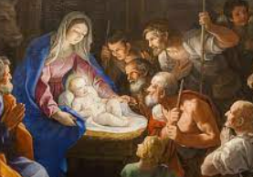
Christmas - Do you think Christmas is a true story?| Year 5|Autumn 2
Truth
True means that a story or event is real. The events are accurate or exact. This can be scientific truth, historic fact or personal truth (faith/belief) There are different versions of the truth told from different perspectives.
Knowledge
There are different versions of the nativity story - The gospel according to St Luke and the gospel according to St Matthew. In St Luke the characters are: Mary, Joseph, Jesus, Shepherds In St Matthew the characters are: Mary, Joseph, Jesus, an Angel, Wise men, Shepherds, Herod The differences are: In Luke: a census (an official count of people) requires Mary and Joseph to travel to Nazareth in Bethlehem. There is no room at the inn. Shepherds visit. In Matthew: An angel appears to Joseph to reassure him. Wise men follow a star to visit Jesus. King Herod (a roman king) he wanted to kill Jesus because he feared that Jesus would take over his throne.
Vocabulary
Gospel | Gos meaning good and spel meaning news – good news. They are the books of the New Testament in the bible retelling Jesus’ life
St Matthew St Luke | These were the evangelists. Along with St John and St Mark They wrote the Gospels in the new testament. Their gospels contained the nativity story.
Nativity | The story of the birth of Jesus
Perspective | A point of view.
Account | A report or a description of an event or experience.
Eyewitness | A person who has seen something happen and can give a description of it.
Incarnation | God took on human form and became Jesus.
.
Saints who wrote the gospels
St Matthew
St Luke
The Nativity scene
Do you need to believe that the story is true to celebrate at Christmas time if you want to?

