Slide 1

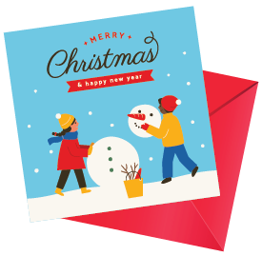
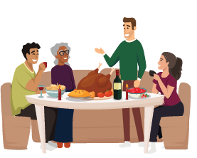

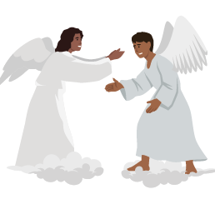

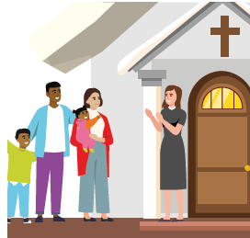
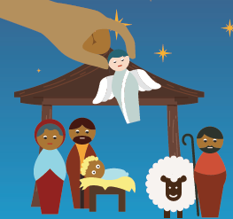

Christianity Year 6 Aut 2 Do Christmas celebrations and traditions help Christians understand who Jesus was?
The giving and
receiving of gifts
and cards
Knowledge
There are different traditions – some religious some non-religious. Some are directly linked to the bible some are not. Christians celebrate the arrival of Jesus as God’s son. At Christmas, people give gifts because the Wise men took gifts to Jesus. People go to church to pray and be reminded of the nativity story. Christians believe that Jesus brought to earth a message from God about how to live a good life. Some Christmas traditions are just for enjoyment so not all traditions relate directly to the bible.
Vocabulary
Celebration Meaningful Traditions Significant Festival Incarnation Advent | Social gathering or important activity held to celebrate something. Serious, important or worthwhile The passing on of customs and beliefs from one generation to the next.
 | Very important and worthy of attention
 | This is a time of special importance to a particular religion.
 | God took on human form by becoming Jesus.
 | This means ‘coming’ and is the period beginning on the 4th Sunday before Christmas. It is a time for preparation.
Messiah | Christians believe that Jesus was the Messiah. The one who was officially favoured by God.
Bible | This is the Christian holy book. It has the Old testament and the New testament.
Christmas dinner
Christmas
wreath
Angels
Star
Christmas – Nativity
Scene celebrating the
Birth of Jesus.
Christmas tree
Going to church

