Slide 1
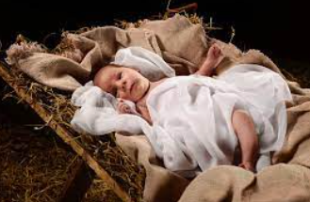
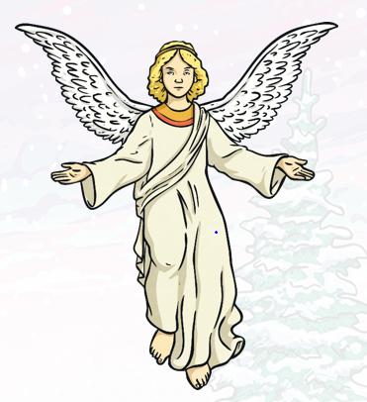
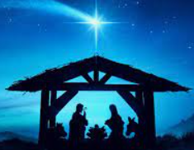
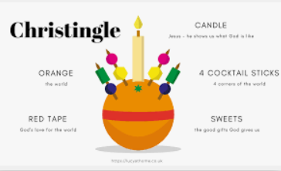
Year 4 Autumn 2 Christmas (Christianity) |What is the most significant part of the Christmas story for Christians?
Knowledge
Christmas is a Christian festival that is celebrated on 25th December. There are many symbols in everyday life. There are lots of symbols in the nativity story. Christingle The orange represents the world. The candle reminds Christians of Jesus whom they believe to be the light of the world. The red ribbon goes all round the 'world' and being the colour of blood, reminds Christians that Jesus died. The four cocktail sticks are the four seasons The sweets (or sometimes dried fruit) remind Christians of God's gifts to the world
Vocabulary
Incarnation | God took human form by becoming Jesus.
Symbol | A mark, picture or character that represents or stands for something else.
Advent | The time beginning on the 4th Sunday before Christmas. It is a time of preparation.
angel | symbolises that Jesus was not just an ordinary man.
Star | guided the wise men just as Jesus is the light that guides people to God.
Wisemen/ shepherds | are an interesting contrast between rich and poor, symbolising that Jesus is a gift from God to everyone.
Manger/ stable | Humble beginnings for a king
Gold Frankincene Myrrh | A precious metal that symbolises how precious Jesus is. This is used in perfume and symbolises Jesus’ priestly role A scented oil. This is an oil which represents Jesus’ death.
Jesus symbolises God’s gift to the world in order to help and save the world.
Angel Gabriel
Star symbolizes Jesus
being the light that
Guides people to God.

