Slide 1
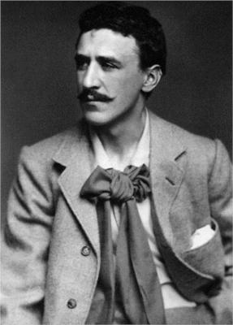
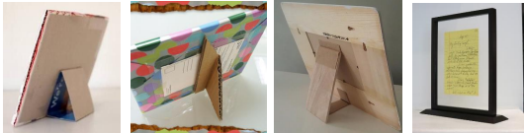
Shirley Heath Photo Frames | Year 3 | Autumn 2
KEY INDIVIDUAL CHARLES RENNIE MACKINTOSH
 | Mackintosh was born in 1868 in Glasgow. He was one of eleven children. Mackintosh worked as an architect designing buildings between 1895 and 1906. He often worked with his wife, Margaret MacDonald. Together they designed everything from furniture to lights and wallpaper for some buildings.
KEY VOCABULARY
Free-standing structure | An object which stands up on its own, without support or attachments
Stable | Fixed in one position - not likely to move, change or fall
Strengthen/reinforce | To combine one or more materials together in order to make something stronger
Component | Different, smaller parts which make up one whole object
Orientation | The direction in which something faces, for example landscape or portrait
KEY KNOWLEDGE
A free standing structure is a structure that stands on its own foundation or base without attachment to anything else. A photo frame is freestanding structure that holds a photo for display, some have a mount and most have glass or plastic to hold the photo in, alongside a base to hold it up.
Key elements of free-standing structures including materials and that the different materials are different strengths. Choices made by the creator of the photo frame according to its qualities to fit a specific audience.
DESIGN BRIEF
Year 3 parents are so proud of their children for making such a fantastic start to their new school! Wouldn’t it be lovely for them to have a wonderful new photo frame for them to display your new school photo? Your challenge is to design a unique photo frame with stylish decoration. Your photo frame must: Have space for a photo to be inserted Stand up independently Hold the decorations attached effectively

