Slide 1
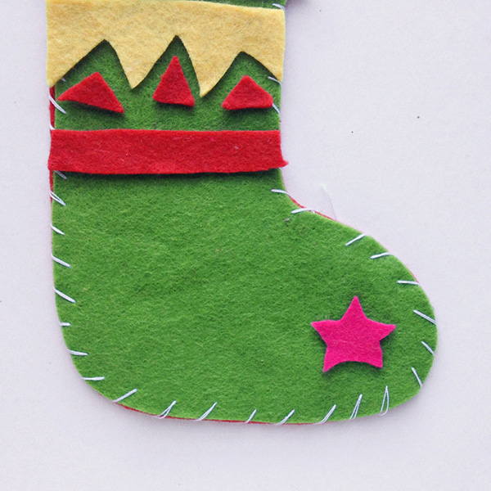
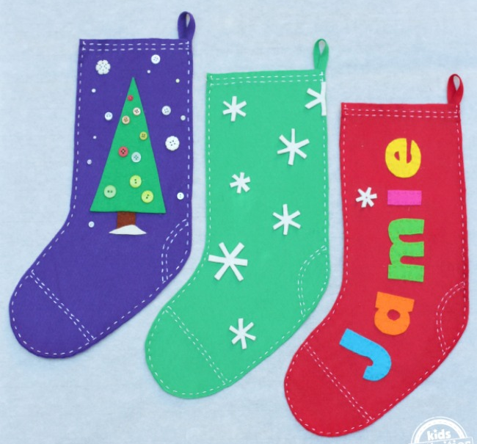



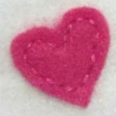
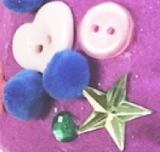
Shirley Heath Seasonal Stockings| Year 4 | Autumn 2
TEXTILES AND BIRMINGHAM
Birmingham has had an established role in the textiles industry since the reign of King Henry II in 1166. By the 14th century, Birmingham was famous for trading materials such as wool and leather, and in the 18th century Birmingham specialised in buttons, hooks and buckles. Although the market for buckles and hooks didn’t last long, the button trade flourished in Birmingham, and even today there are traces of old ‘button factories’ around the city!
STITCH TYPES
1 | Running Stitch |  | The running stitch or straight stitch is the basic stitch in hand-sewing.
2 | Over Stitch |  | This stitch goes over the edge of the fabric, protecting your raw edges or bringing two edges together.
INCLUDING DECORATIONS
DESIGN BRIEF
The Year 4 children at Shirley Heath have been asked to create their own ‘seasonal stockings’ using textile materials. Your design must be aesthetically pleasing with decorations that are suitable for the time of year. These stockings should be reusable year on year, so it is important that your pieces are attached sufficiently.
LEARNING OUTCOME
To be able to join two pieces of material together using one or more sewing patterns.

