Slide 1
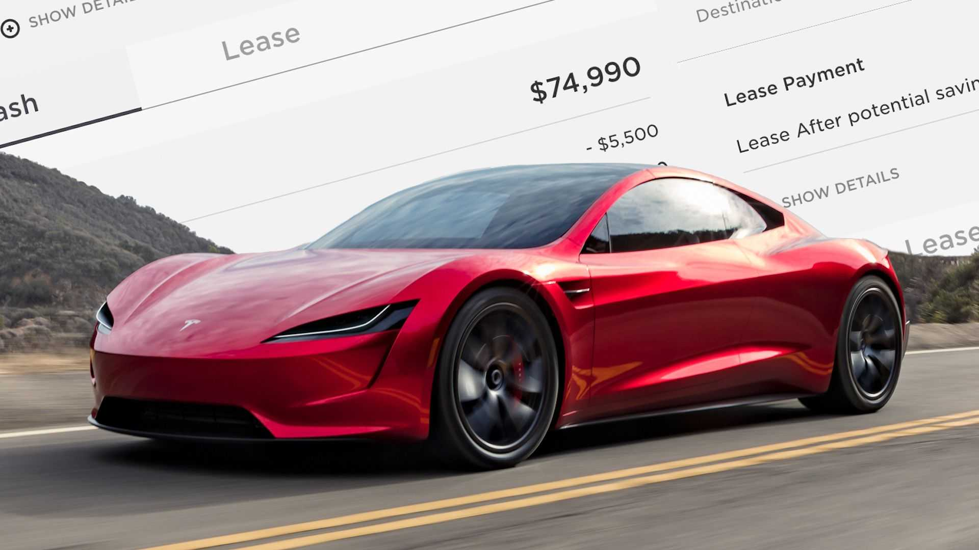
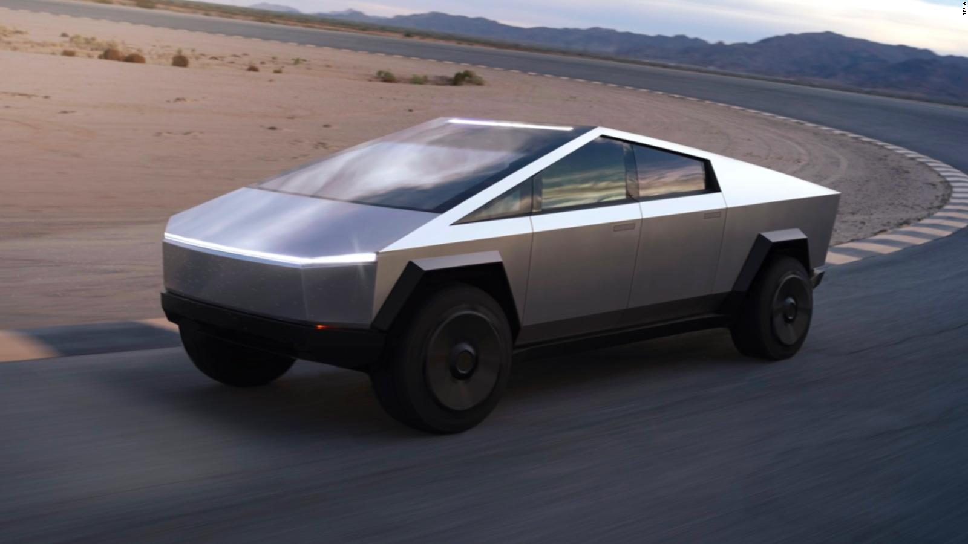
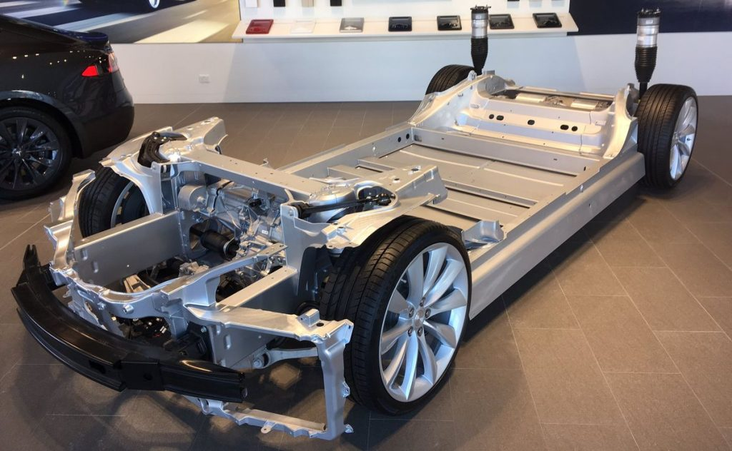
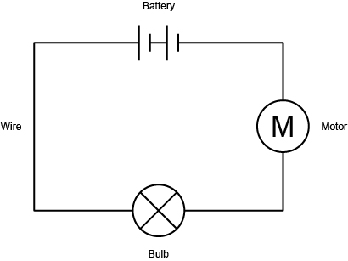
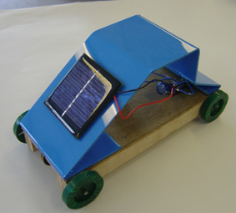
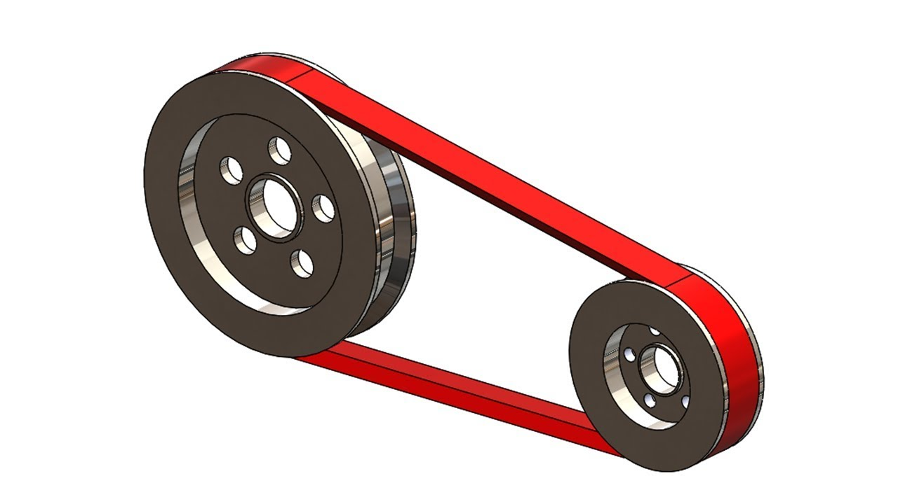
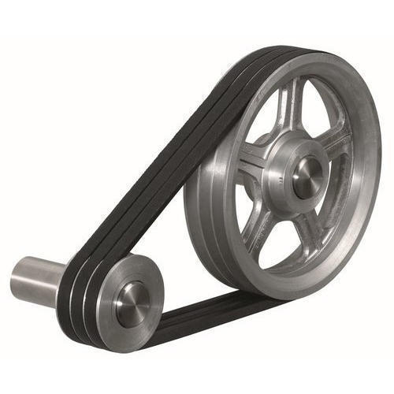
Shirley Heath Electric Cars| Year 5 | Autumn Term
Tesla, Inc.
 | Tesla, Inc. is an American electric vehicle and clean energy company based in California founded by Martin Eberhard and Marc Tarpenning. Eberhard and Tarpenning’s goal was to create a car that is recognised for its technology, with its core technologies as the battery and the proprietary motor.
BRIEF
Structure
Design | You will need to create a wooden structure to encase your electrical system. It must be strong enough to withstand a journey. Your vehicle will travel in a linear motion.
Vocabulary | Structure, secure, frame, prototype, component, rigid, stability, strength, axel
Electrical and Mechanical System
Circuit with motor | Most importantly, your vehicle will need to travel. You will need to create a secure, working circuit containing a motor to enable your car to move along the ground.
Axle | A rod or shaft that connects a pair of wheels to propel them and retain the position of the wheels to one another.
Chassis | Chassis is the load-bearing part of the frame – the 'frame', then, is the rest of the structural body of the car.
KEY SKILLS
Cutting Using the a saw to carefully cut the wood to the required lengths for your structure.
Joining Choosing a range of the most effective and secure joining methods to build the different components of your vehicle. To join the wood with glue at right angles to make a secure chassis.
Electrical element Your simple circuit will need to include a switch, a battery and a motor.
Wheels The wheels are attached using an axle to attach both together. This needs to be cut straight with the wheels at an equal angle.
Mechanical element A pulley is a wheel on an axel or shaft that is designed to support movement. Your pulley will be attached to your motor to enable your vehicle to rotate.
KEY QUESTION
Tesla’s CEO, Elon Musk, is always looking for new, innovative ideas to improve the carbon footprint of the cars that the company create. He would like to design a new electric car that produces as little pollution as possible. The cars that Tesla currently manufacture can be very large, quirky and expensive. Can you help him to create a more affordable, appealing and environmentally friendly vehicle?

