Slide 1
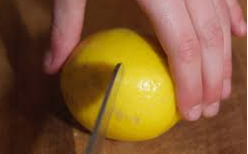
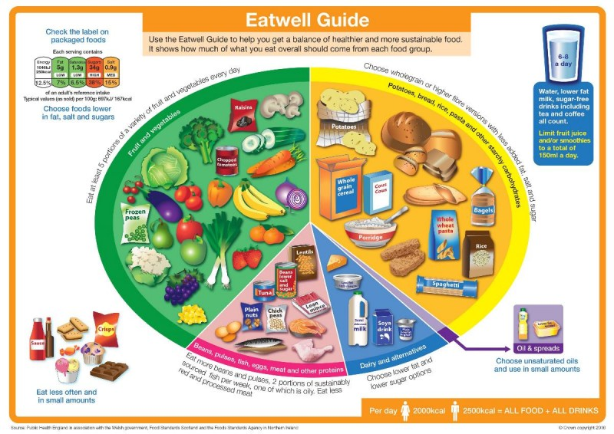
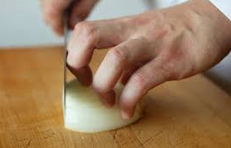


Shirley Heath Pinwheel Pizzas and Mighty Muffins Year 6| Autumn 2
KEY QUESTION
Children are becoming more and more unhealthy because they snack too much on the wrong type of foods. How can we help children understand what they need to eat to have a healthy balanced lifestyle?
KNIFE SKILLS
BRIDGE HOLD Create a bridge over the food with your hand. This method ensures that fingers are out of the way as the knife cuts through the food.
CLAW GRIP Create a claw by partly curling your fingers together into a claw shape. This method ensures that finger tips are tucked out of the way and will not get caught by the knife.
THE EATWELL PLATE
potatoes, bread, rice, pasta and other starchy carbohydrates. | Carbohydrates provide energy for all cells in the body.
beans, pulses, fish, eggs, meat and other proteins. | Protein helps to build and repair the body. Protein is an important building block of bones, muscles, cartilage, skin, and blood.
fruit and vegetables. | Fruit and vegetables are a good source of vitamins, minerals and fibre.
dairy and alternatives. | Dairy products include calcium, that young children need to build healthy bones and teeth.
Oils and spreads. | These provide us with essential fatty acids.
KEY PERSON
JOE WICKS
Joe Wicks, otherwise known as "The Body Coach", is a British fitness coach, TV presenter and author. Starting off by posting 15-second recipe videos on social media, Wicks grew his brand to become one of the most followed fitness accounts on Instagram and YouTube. His first published cookbook Lean in 15: 15-minute meals was a best-seller in 2015, having sold over 900,000 copies.
COOKING TECHNIQUES
whisk | A whisk is a cooking utensil which can be used to blend ingredients smooth or to incorporate air into a mixture, in a process known as whisking.
Sift | To put one or more dry ingredients through a sieve or sifter.
roll | Put your hands in either end of the rolling pin and roll until your dough is the correct thickness all over.
grease | Smear a small amount of fat, such as margarine, all over the inside of the tin you are cooking in.
Dice | To cut food in small cubes of uniform size and shape.
Knead | To work and press dough with the palms of the hands or mechanically, to develop the gluten in the flour.

Slide 2
Shirley Heath Pinwheel Pizzas and Mighty Muffins Year 6| Autumn 2
KEY QUESTION
How can we help children understand what they need to eat to have a healthy balanced lifestyle?
KNIFE SKILLS
BRIDGE HOLD Create a bridge over the food with your hand.
CLAW GRIP Create a claw by partly curling your fingers together into a claw shape.
COOKING VOCABULARLY
whisk | A whisk is a cooking utensil which can be used to blend ingredients smooth or to incorporate air into a mixture, in a process known as whisking.
sift | To put one or more dry ingredients through a sieve or sifter.
roll | Put your hands in either end of the rolling pin and roll until your dough is the correct thickness all over.
grease | Smear a small amount of fat, such as margarine, all over the inside of the tin you are cooking in.
dice | To cut food in small cubes of uniform size and shape.
knead | To work and press dough with the palms of the hands or mechanically, to develop the gluten in the flour.
seasonality
balanced diet
Key information from lessons currently missing:
Seasonality
Locally sourced food
Balanced diet
On MTP – analysing a recipe, reared, grown, caught or processed – not taught last year
KEY PERSON
JOE WICKS
Joe Wicks, otherwise known as "The Body Coach", is a British fitness coach, TV presenter and author. Starting off by posting 15-second recipe videos on social media, Wicks grew his brand to become one of the most followed fitness accounts on Instagram and YouTube.
How is food sourced?

