Slide 1

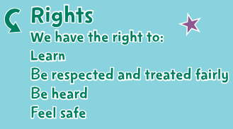
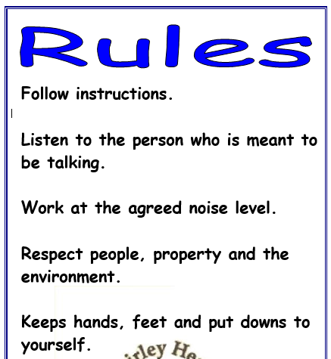
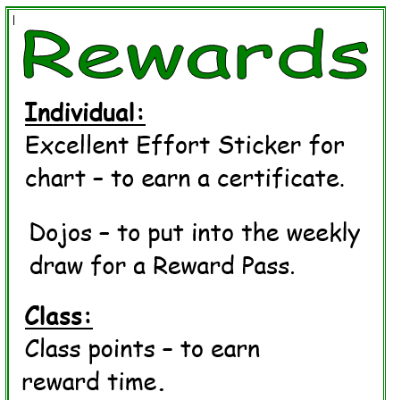
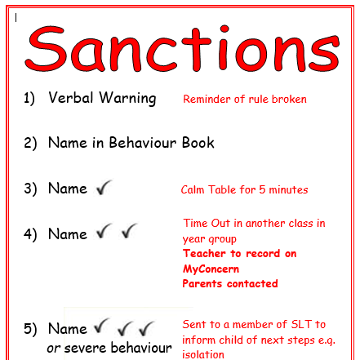
Shirley Heath Being Me in My World| Year Three| Autumn 1 P.S.H.E.
The Jigsaw Charter
We take turns to speak
We use kind and positive words
We listen to each other
We have the right to pass
We only use names when giving compliments or making a positive comment
We respect each other’s privacy
Finding your Superpower
I am confident
I am unique
I have superpowers
Vocabulary
achievements | Things that you have done that you feel proud of
collaborate | To work in a group
consequences | The result of something happening eg sanctions
cooperate | To work with others politely and listen to their point of view
empathy | To be able to understand someone else’s feelings and point of view
opportunities | The chance to do something
responsibilities | Something you are required to do
rewards | A thing given for praise- verbal or an object eg sticker
rights | Things that every person should have
valued | To make someone feel that they are welcome and they belong.

