Slide 1

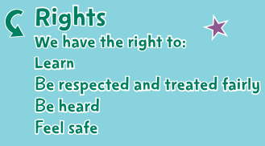
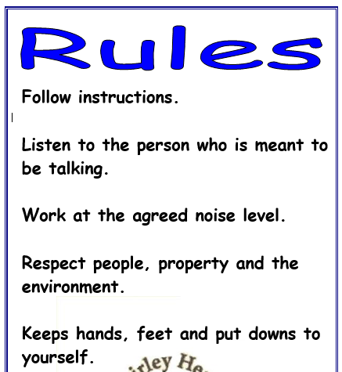
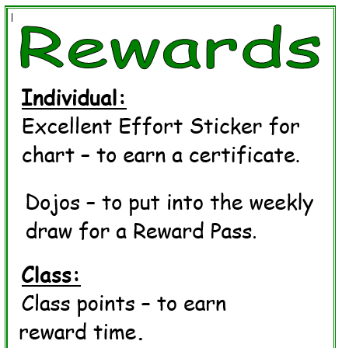
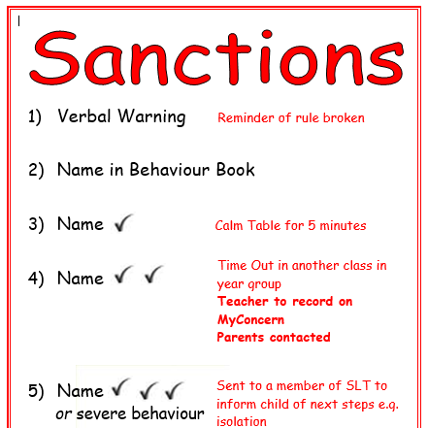
Shirley Heath Being Me in My World| Year Four| Autumn 1 P.S.H.E.
The Jigsaw Charter
We take turns to speak
We use kind and positive words
We listen to each other
We have the right to pass
We only use names when giving compliments or making a positive comment
We respect each other’s privacy
Finding your Superpower
I am confident
I am unique
I have superpowers
Vocabulary
authority | A person who is in charge
consequences | The result of something happening eg sanctions
empathy | To be able to understand someone else’s feelings and point of view
excluded | To not feel part of a group or activity
included | To feel a part of a group or activity
Job description | A list of things that you expect a person to do/ways you expect a person to behave
responsibilities | Something you are required to do
rights | Things that every person should have
UNCRC | An agreement across the world of the rights that each child should have
valued | To make someone feel that they are welcome and they belong

