Slide 1

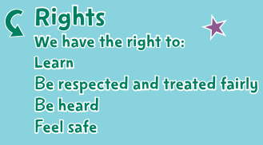
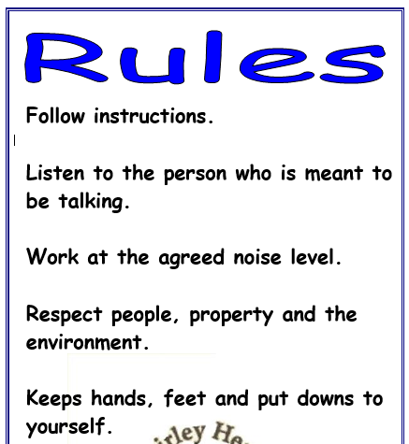
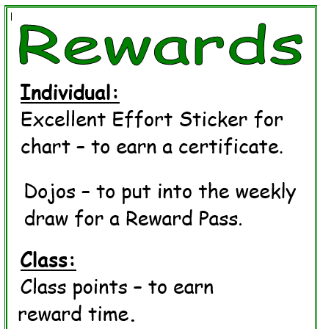
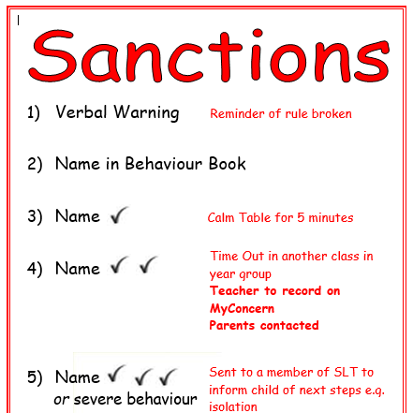
Shirley Heath Being Me in My World| Year Five| Autumn 1 P.S.H.E.
Vocabulary
British citizen | If your parents were born in the UK, you are considered to be a British citizen.
consequences | The result of something happening eg sanctions
denied | Not allowed to do something
empathy | To be able to understand someone else’s feelings and point of view
goals | An aim or target
opportunities | The chance to do something
prejudice | To have an opinion about something or someone before you do it or meet the person- not based on fact
refugees | Are people escaping from conflict or persecution.
responsibilities | Something you are required to do
rewards | A thing given for praise- verbal or an object eg sticker
rights | Things that every person should have
The Jigsaw Charter
We take turns to speak
We use kind and positive words
We listen to each other
We have the right to pass
We only use names when giving compliments or making a positive comment
We respect each other’s privacy
Finding your Superpower
I am confident
I am unique
I have superpowers

