Slide 1
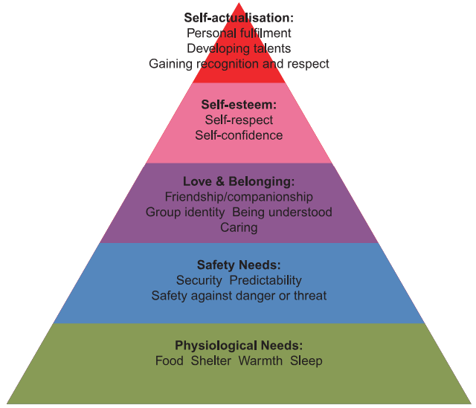

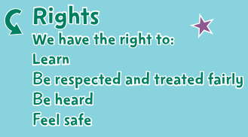
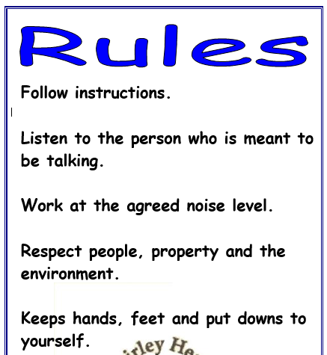
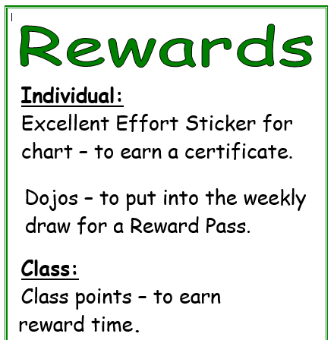
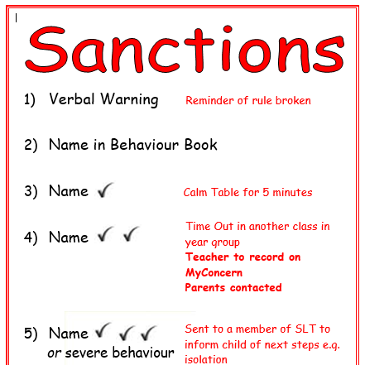
Shirley Heath Being Me in My World| Year Six| Autumn 1 P.S.H.E.
The Jigsaw Charter
We take turns to speak
We use kind and positive words
We listen to each other
We have the right to pass
We only use names when giving compliments or making a positive comment
We respect each other’s privacy
Finding your Superpower
I am confident
I am unique
I have superpowers
Vocabulary
Anti-social behaviour | a range of nuisance and criminal behaviours which are causing distress to others e.g playing loud music.
motivation | To want to do or achieve something
obstacles | Things stopping you from achieving your goals
opportunities | The chance to do something
resilience | means that we develop an ability to deal with problems, we recover quickly from set-backs.
responsibilities | Something you are required to do
rights | Things that every person should have
stereotyping | to believe unfairly that all people or things with a particular characteristic are the same
values | What you think is important in life

