Slide 1
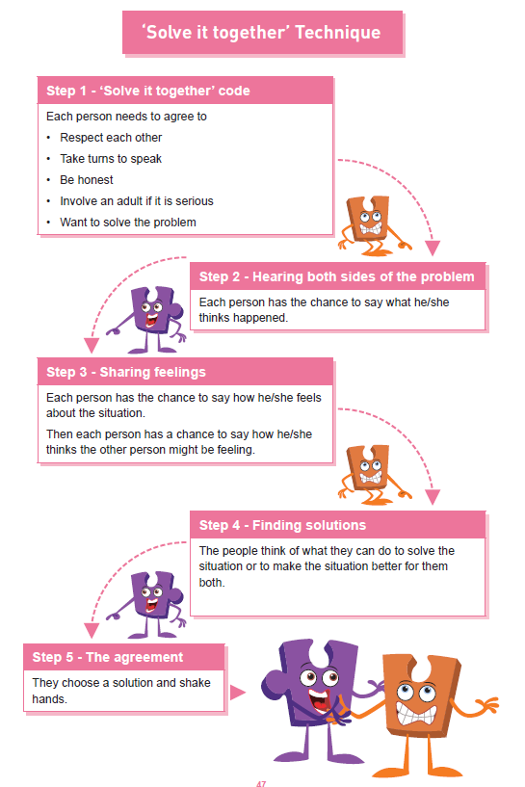



Shirley Heath | Celebrating Difference Year Three| Autumn 2 P.S.H.E.
Equality act 2010
The Equality Act 2010 makes it illegal to discriminate against people in any way on the basis of any of the characteristics below. This aims to promote fairness and equality and protect everyone in Britain from being treated differently to others.
Vocabulary
bystander | Someone who watches something happen but does not take part.
conflict | Argument or fight.
connected | Joined.
consequences | Actions that happen because of someone’s behaviour.
compliment | To say something nice/kind to someone.
difference | If something is not the same.
gay | Being gay is when someone is attracted to someone of the same gender as them. This should never be used as an insult.
resolve | To sort out an argument or fight.
solution | To find a way of making the problem better.
special | Different or important or precious.
stereotyping | to believe unfairly that all people or things with a particular characteristic are the same
witness | Someone that watches an event happen.
Protected Characteristics
There are nine protected characteristics, these are: age disability gender reassignment marriage and civil partnership pregnancy and maternity race religion or belief sex sexual orientation

