Slide 1
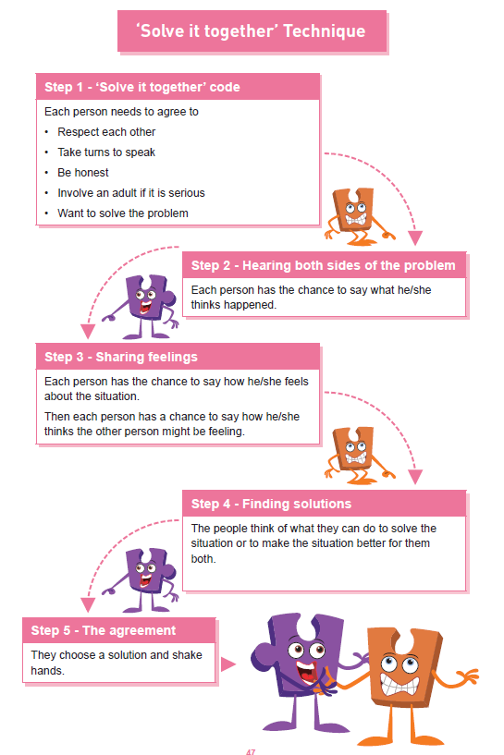

Shirley Heath | Celebrating Difference Year Four| Autumn 2 P.S.H.E.
Equality act 2010
The Equality Act 2010 makes it illegal to discriminate against people in any way on the basis of any of the characteristics below. This aims to promote fairness and equality and protect everyone in Britain from being treated differently to others.
Vocabulary
assumption | A thought that is accepted as true without any proof.
bystander | Somebody who watches an event but does not join in.
characteristics | A feature or quality belonging to a person.
cyber bullying | To bully a person using technology e.g. text, snapchat, Instagram, email.
deliberate | On purpose.
empathise | To understand and share the feelings of another person.
impression | An idea, feeling or opinion about someone.
judgement | To make a decision about someone or something.
stereotyping | to believe unfairly that all people or things with a particular characteristic are the same
trolled | To be upset by a person online.
unique | Being one of a kind; not like anyone else.
witness | A person who sees an event.
Protected Characteristics
There are nine protected characteristics, these are: age disability gender reassignment marriage and civil partnership pregnancy and maternity race religion or belief sex sexual orientation

