Slide 1
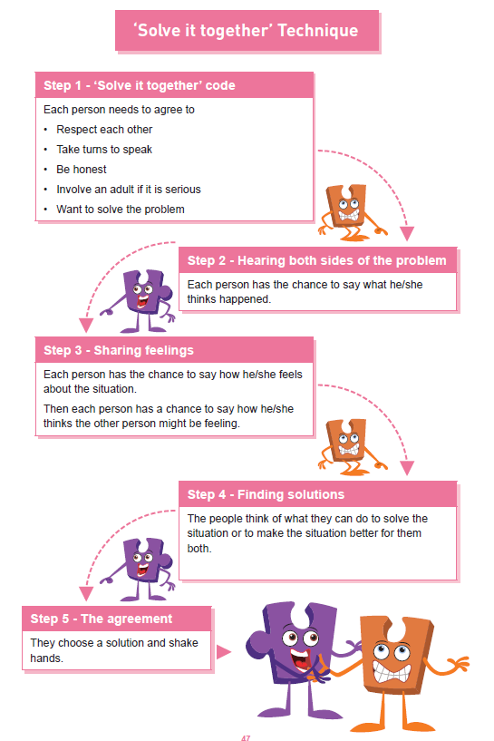

Shirley Heath | Celebrating Difference Year Five| Autumn 2 P.S.H.E.
Equality act 2010
The Equality Act 2010 makes it illegal to discriminate against people in any way on the basis of any of the characteristics below. This aims to promote fairness and equality and protect everyone in Britain from being treated differently to others.
Vocabulary
conflict | An argument or fight.
cultural | The ideas and customs of a society.
developing world | Countries that are not as well resourced as ours.
direct bullying | A person bullying someone through unkind words or actions to their face.
discrimination | Treating someone differently because of their religion, age, gender etc.
homophobic | Disliking people because they are attracted to the same gender as themselves. Calling people inappropriate names.
indirect bullying | Bullying someone behind their back e.g. spreading rumours, whispering secrets etc.
racism | Disliking a group of people because they are a different skin colour, have different beliefs or religion.
rumour | Passing on a story that is not true to cause upset.
wealth | To have lots of money and possessions (belongings).
Protected Characteristics
There are nine protected characteristics, these are: age disability gender reassignment marriage and civil partnership pregnancy and maternity race religion or belief sex sexual orientation

