Slide 1
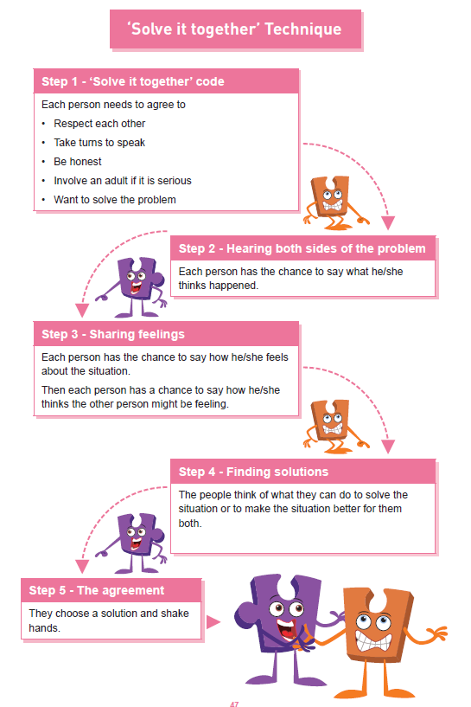

Shirley Heath | Celebrating Difference Year Six| Autumn 2 P.S.H.E.
Equality act 2010
The Equality Act 2010 makes it illegal to discriminate against people in any way on the basis of any of the characteristics below. This aims to promote fairness and equality and protect everyone in Britain from being treated differently to others.
Vocabulary
cerebral palsy | A condition where the person has less control over their muscles- this affects speech and movement.
control | The ability to make people feel that you can change their behaviour- that you are in charge/better than them.
direct and indirect bullying | Direct bullying is when a person hurts another with words or actions to their face. Indirect bullying is when someone bullies behind their back e.g. rumour spreading, whispering.
disability | A physical or mental condition that limits a person’s movements, senses or activities.
harassment | To pressure someone or make them feel less powerful than you.
imbalance | Not equal.
perception | What you think about something.
power | The ability to have control over someone
prejudiced | Unlike people and treat people unfairly without knowing about them.
role model | A person who is looked to by others as a good example of behaviour.
visual impairment | The person can not see as well as normal.
Protected Characteristics
There are nine protected characteristics, these are: age disability gender reassignment marriage and civil partnership pregnancy and maternity race religion or belief sex sexual orientation
Useful Websites-
Kidscape: www.kidscape.org.uk
ChildLine: www.childline.org.uk
Thinkuknow www.thinkuknow.co.uk

