Slide 1
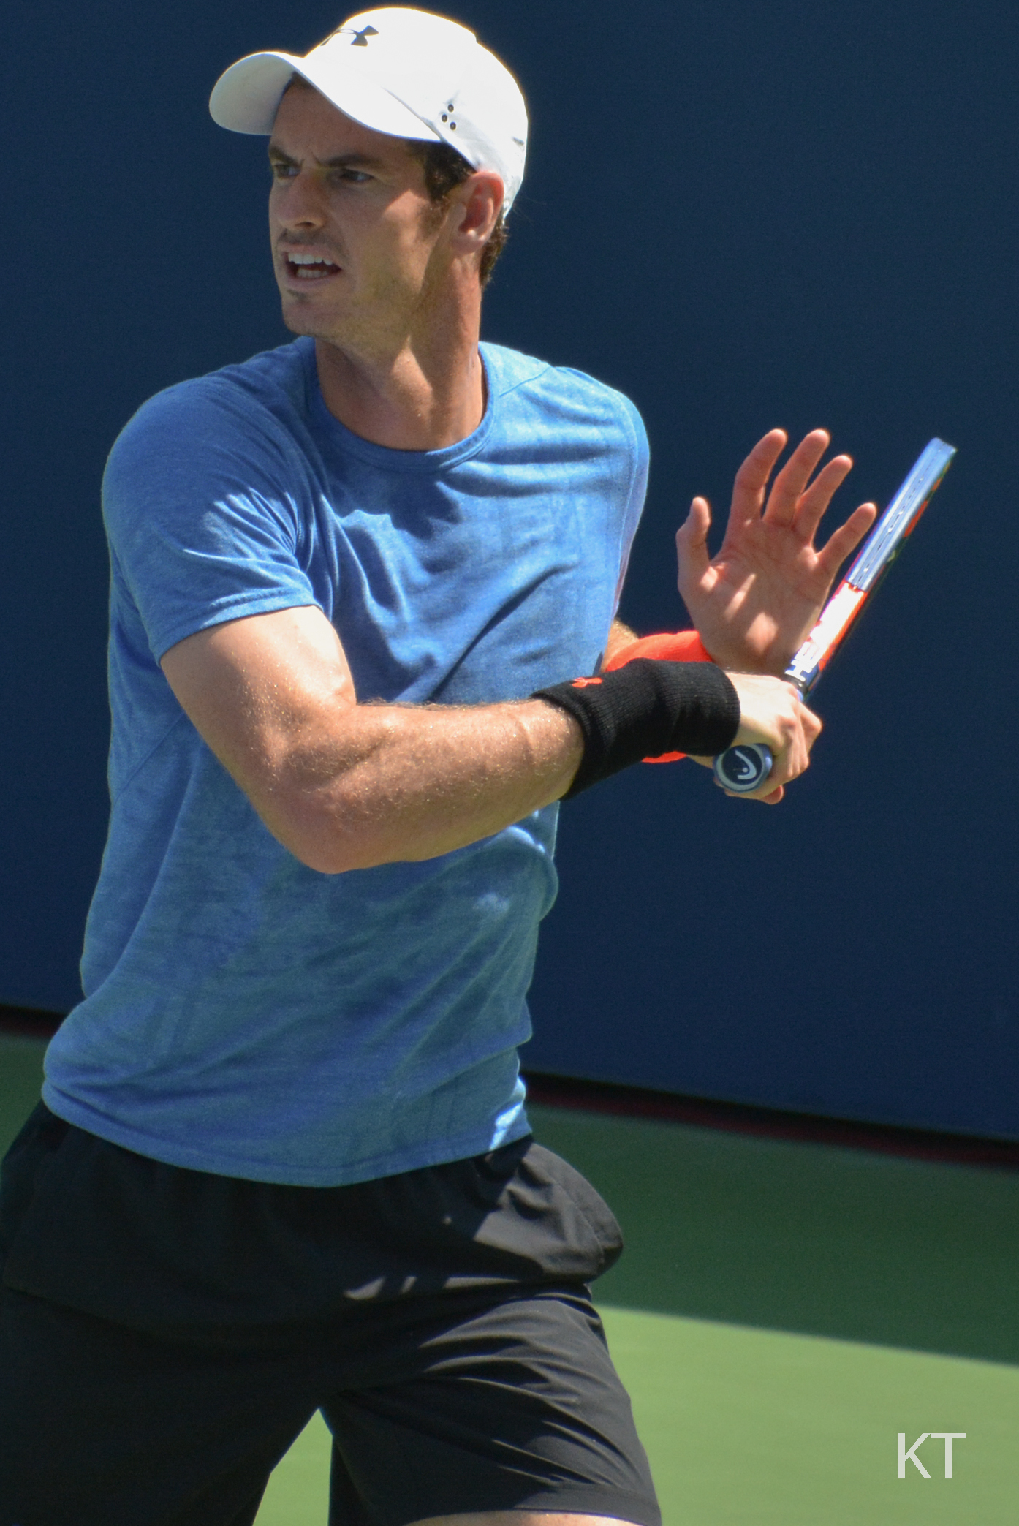
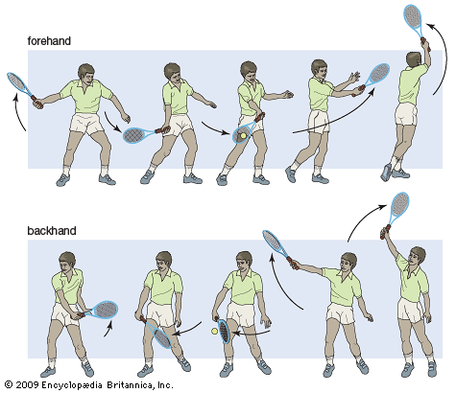
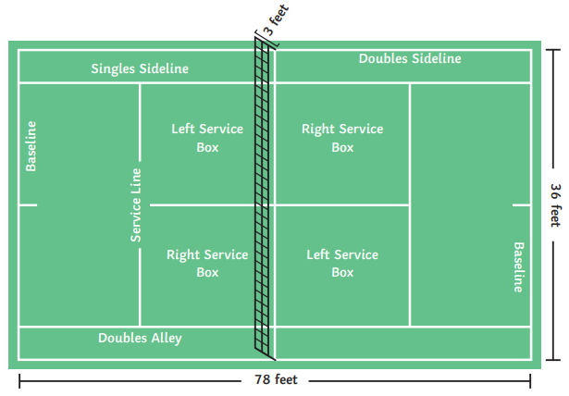
Shirley Heath Year 3, Autumn 1: Tennis
Skills
1 | Stroke technique | A method used to hit the ball including forehand, backhand, volley, lob and overhead. (See forehand and backhand skill below – picture to support)
2 | Ready position | A skill and a starting position to get the body ready to return the serve and hit a stroke.
3 | Match play | A technique used to understand the basics of the game, the rules, the scoring and the court.
Vocabulary
1 | Forehand (to hit the ball) | a stroke played with the palm of the hand facing in the direction of the stroke.
2 | Backhand (to hit the ball) | a stroke played with the back of the hand facing in the direction of the stroke, with the arm across the body.
3 | Serve | The first shot played in a point / rally
4 | Movement | Running / jumping to perform a shot or to get into a positon to return
5 | Return (to hit the ball) | Hitting the ball back in the direction of your opponent (attempting to score a point).
Sir Andy Murray OBE:
Murray is a British professional tennis player who represents Great Britain in his sporting activities and is a three-time Grand Slam tournament winner, two-time Olympic champion, Davis Cup champion, winner of the 2016 ATP World Tour Finals, and former world No. 1.
Forehand & Backhand technique:
Match (Context)
A match is divided into sets. A set is won when a player reaches 6 games. A match is won when a player has won 2 sets – apart from in Grand Slam tournaments, when male players must win 3 sets.

