Slide 1
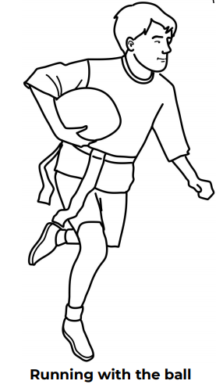
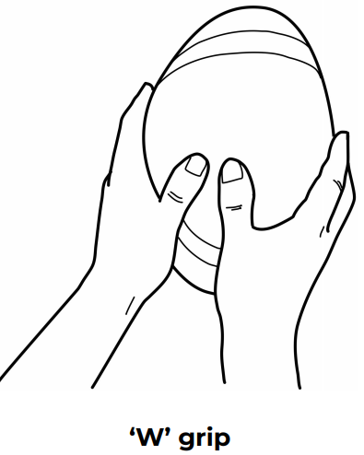
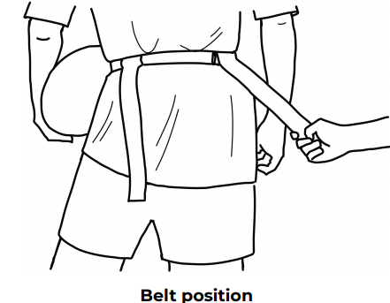
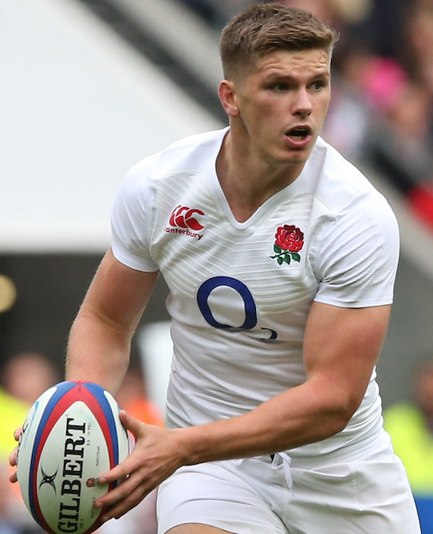
Shirley Heath Year 3, Autumn 2: Tag Rugby (Edwardians RFC)
Skills
1 | Running Past Defenders | As an attacker, running past opposition players in an attempt to score a try.
2 | Handling a Rugby Ball | Holding a rugby ball in a ‘W’ position.
3 | Evading Tags | Running in a variety of directions / moving the ball to retain possession and not get tagged.
4 | Tag Protocol | See rules below.
5 | Closing Down Attackers | Cutting down the space so an opposition player cannot get passed you.
Vocabulary
1 | Space | Being in a position where there is room for you to move.
2 | Mark | Standing by an opposition payer so they cannot access the ball / move easily.
3 | Dodge | Jockey your body to prevent being tagged.
4 | Footwork | Being able to move quickly in different directions.
5 | Possession | Having control of the ball.
6 | Evading | Not being tagged by an opposition player.
7 | Try | Scoring a point by putting the ball down past the oppositions try line.
Rules
Only the ball carrier can be tagged. When the ball carrier is tagged, they must pass the ball within 3 seconds Defenders must return the tags in a sportsmanlike manner
Owen Farrell:
Owen Andrew Farrell is an English professional rugby union player, currently playing for Premiership Rugby side Saracens and is captain of the England National Team. Farrell has played international rugby for England since 2012.

