Slide 1
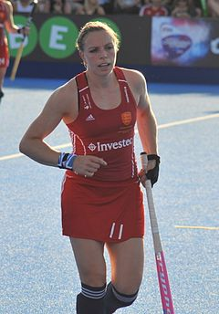
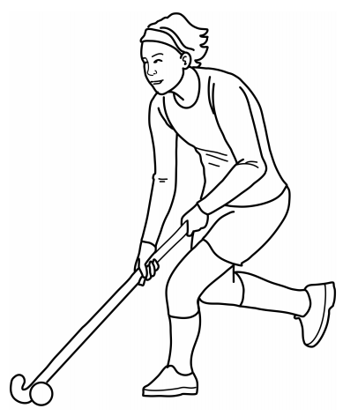
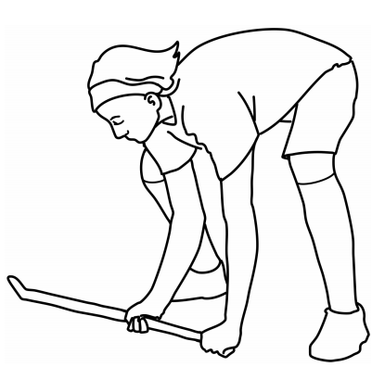
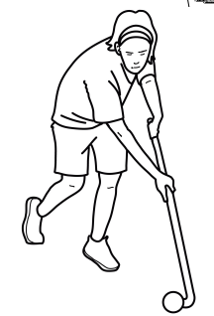
Shirley Heath Year 4, Autumn 1: Hockey
Vocabulary
1 | Free Space | An area in the field where there is no opposing players.
2 | Losing an Opponent | Dribbling / Moving past an opponent whilst creating an attacking move
3 | Timing | When to strike the ball with the stick.
4 | Decision Making | Deciding to play the right shot prior to striking the ball.
5 | Power | How hard to hit the ball.
6 | Reaction Time | How long it takes the player to
7 | Stamina | The ability to sustain prolonged physical or mental effort.
Skills
1 | Ball control | A variety of skills to control the ball including dribbling, stopping and striking.
2 | Defending | This includes the physical act of dispossessing the opponent or otherwise preventing them from passing, dribbling or scoring. Equally, a player must be aware of what position to take up in order to be effective in the passage of play.
3 | Attacking | This includes the physical act of dribbling or passing the ball in order to create the opportunity to score. Equally, a player must be aware of what position to take up in order to be effective in the passage of play.
4 | Shooting | Hitting the ball within a goal post to score a point. A player may do this with force in an attempt to deceive the opposition goalkeeper.
5 | Passing (slap pass) | Moving the ball via the flat side of the players wooden stick to another player on their team.
6 | Dribbling | Moving with the hockey ball using the inside and outside of the hockey stick.
Kate Richardson-Walsh
Richardson-Walsh is an Olympic Gold and Bronze Medal winning English hockey player. She was capped a record 375 times for her country and was the England and Great Britain Captain for 13 years.
Reverse Stick
Ball Carrying
Block Tackle

