Slide 1
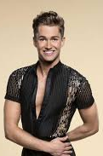
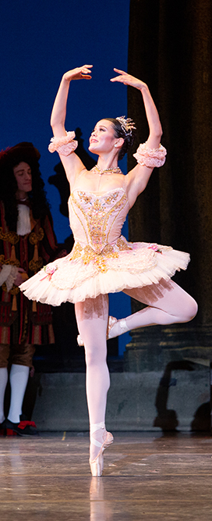
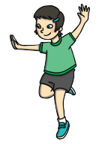
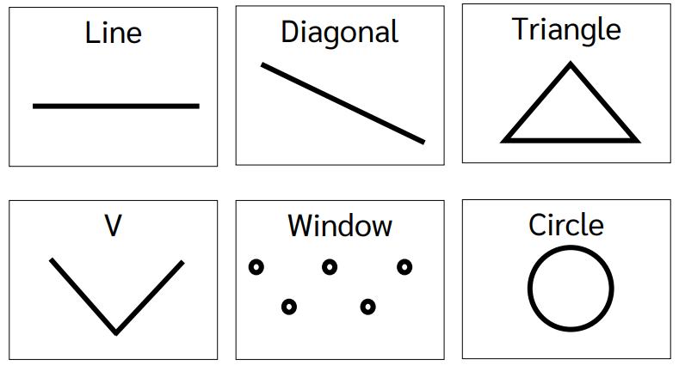
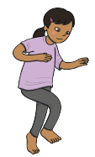
Shirley Heath Year 4, Autumn 2: Dance
Skills and Vocabulary
1 | Balance | Being able to keep a stable body (without wobbling or falling) over a base of support (Eg, Hands or feet)
2 | Freeze frame | Producing a still image of a certain part of a routine.
3 | Body Awareness | Understanding how your body is moving in time to the music, without having to look in a mirror.
4 | Control | The power to direct your body and body parts to master dance moves
5 | Co-ordination | Being able to move different body parts at the same time.
6 | Dynamics | Being able to change your body moves. Eg, fast, slow, jerky, smooth etc.
7 | Facial Expression | Being able to show a story through the using your face.
8 | Spatial Awareness | Using the correct amount of space when performing. This links to the safety aspect of the sport.
AJ Pritchard:
Pritchard is a British dancer from Stoke. He is well known for being able to dance in 7 different ways and has performed with non-dancing athletes such as British Paralympian, Lauren Steadman.
Move into…
Pirouette Full turn:
Using one standing foot to move your body 360 degrees
Hopping
Formations of Dance
Synchronise (link together) using different formations of dance
Tiptoeing

