Slide 1
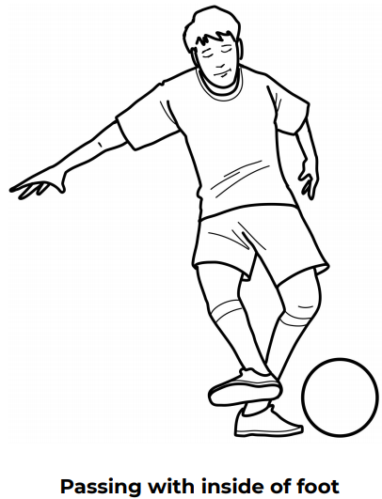
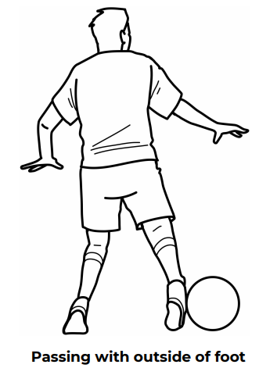
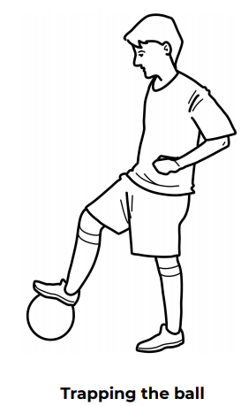
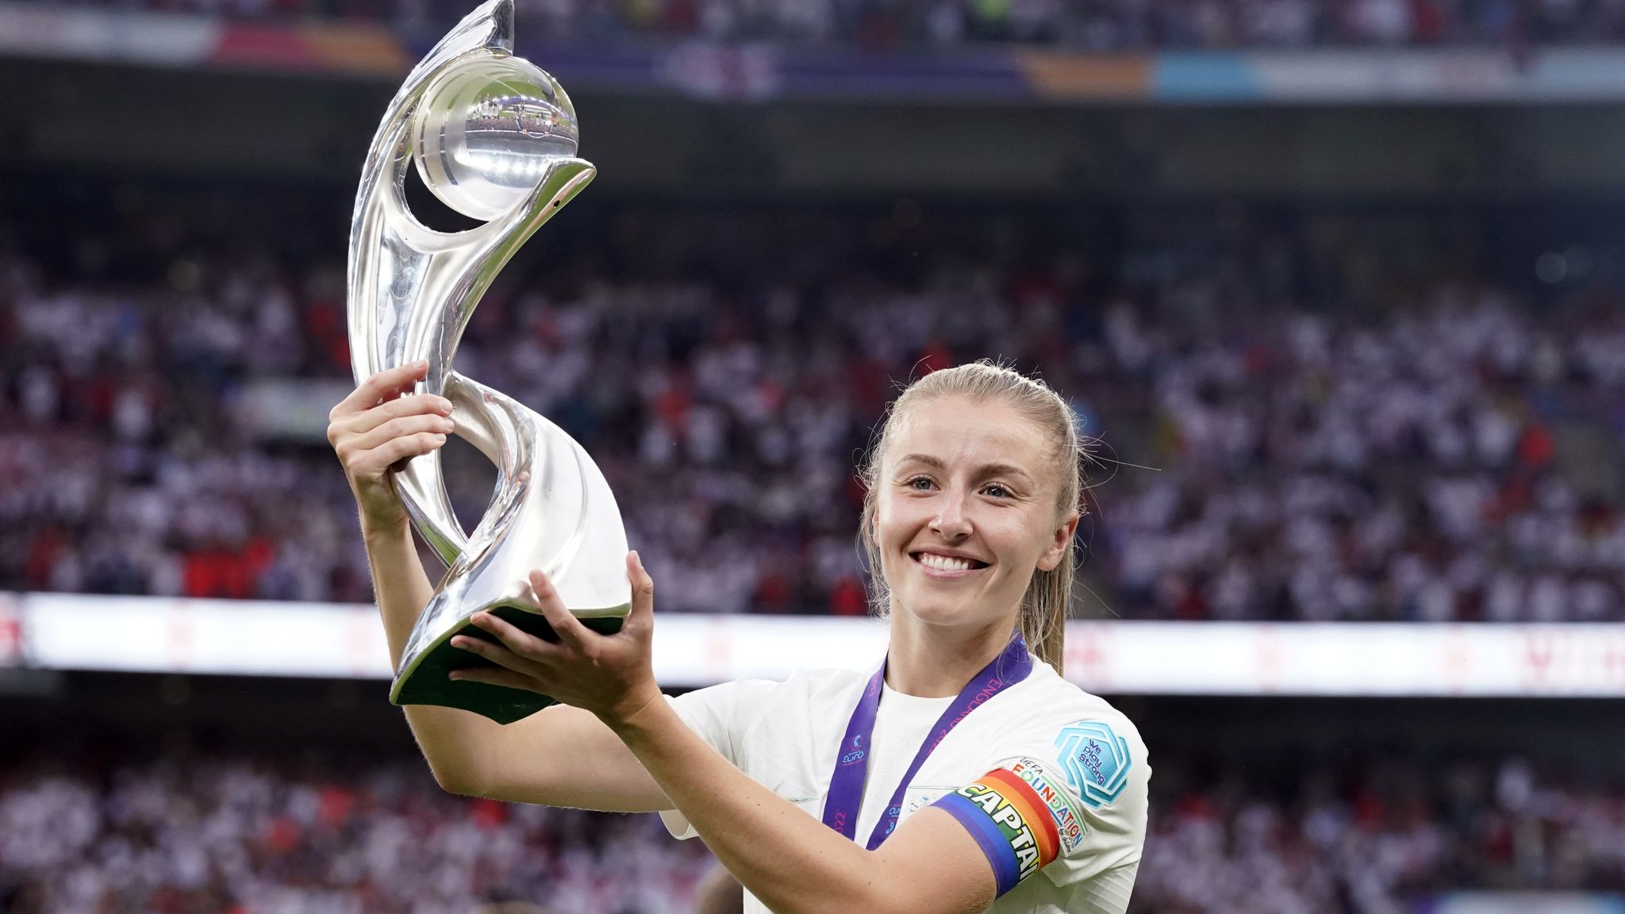
Shirley Heath Year 5, Autumn 1: Football
Vocabulary
1 | Control | To know where the ball is going / has gone.
2 | Attack | To go forward in an attempt to score
3 | Defend | To resist an attack by preventing a scorer
4 | Pass | To move the ball to another play via the foot.
5 | Shoot | Kick the ball towards the goal in an attempt to score
6 | Kick | Strike a ball, with force, using a players foot.
7 | Goalkeeper | To prevent a goal (can use their hands within penalty box ONLY)
8 | Score | To get the ball in the oppositions goal.
9 | Teamwork | Working together to achieve a certain goal
10 | Tackle | Take the ball off an opponent using your feet
Skills
1 | Passing | using the inside of the foot to move the ball is the most accurate but can lack speed. Using the outside of the boot can create swerve but is not always accurate (and is the most difficult way to kick the ball). Kicking the ball with the laces will pass the ball the quickest however may be difficult for a teammate to control.
2 | Shooting | Use your laces or inside of the foot. Leaning back with mean the ball is will travel in the air. A side foot will increase the accuracy of the ball going to a certain area but will lack power.
3 | Dribbling (and turning with the ball) | Head up, looking in the desired location. Using the inside and outside of the boot to keep the ball on the floor. When receiving the ball, turn into open space.
Leah Williamson:
Leah Williamson is an English footballer who plays for Arsenal and the England national team. Williamson captained England to their first major football tournament win – the European Championship in 2022 – for the first time since the men won the World Cup in 1966.

