Slide 1
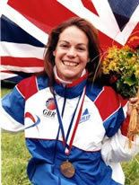
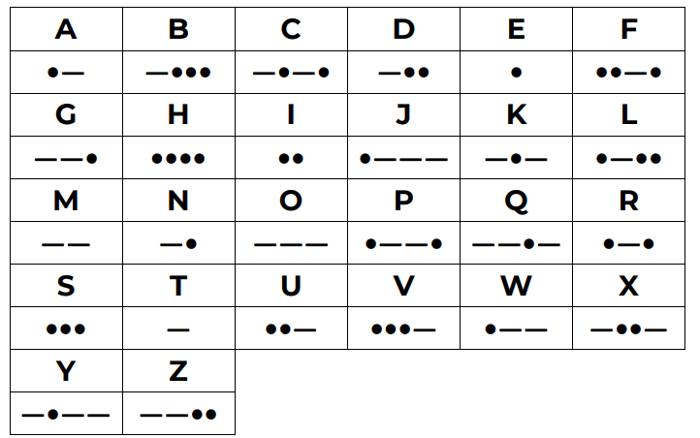

Shirley Heath Year 5, Autumn 2: Orienteering (OAA)
Vocabulary
1 | Map | A diagrammatic representation of an area showing physical features
2 | Key | Explains the meanings of symbols
3 | Grid reference | Map reference indicating a location in terms of a series of vertical and horizontal grid lines
4 | Morse Code | An alphabet or code in which letters are represented by combinations of long and short light or sound signals.
5 | Instructions | A direction or order
Skills
1 | Following Instructions | Completing a problem in a logical way to achieve an end goal.
2 | Commun-icating | Discussing with team members to achieve a goal.
3 | Map reading | Recognising symbols on a map and navigating to different areas an objects.
4 | Route | A way from getting from a starting point to a destination
5 | Orienteer | To find your way across areas using a map.
6 | Solve | Working something out to achieve success.
7 | Orient | align or position (something) relative to the points of a compass or other specified positions.
Morse Code
←
Yvette Baker:
Baker is Britain’s most successful orienteer. She has won both the British Orienteering Championship and the JK Orienteering Festival multiple times.
← Orienteering Pictogram and International Flag

