Slide 1
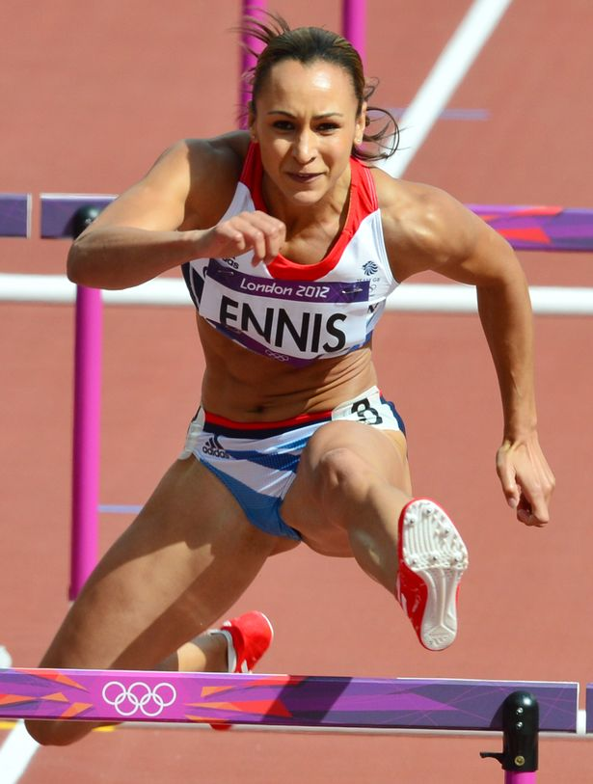
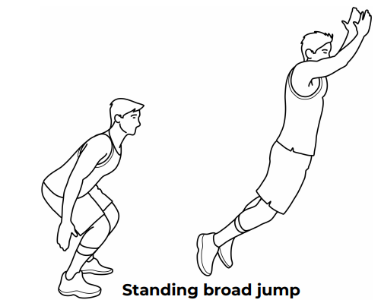
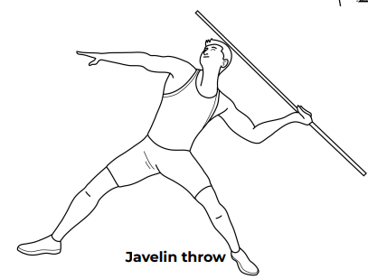
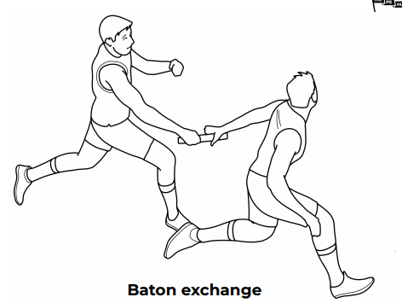
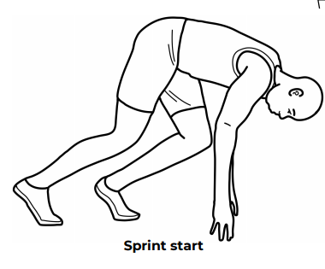
Shirley Heath Year 6, Autumn 1: Athletics
Skills
1 | Running Distance of 600m / power in a sprint start | An action to move quickly with the correct technique using arms and legs as effectively as possible.
2 | Jumping Moving towards long-jump | The technique to propel the body into the air to cover distance, height or both.
3 | Throwing Vortex Howler / Javelin | The ability to propel the an object through the air as fast, and as far, as possible.
4 | Teamwork | Working with others to achieve an end goal.
Vocabulary
1 | Throw | Propel (something) with force through the air by a movement of the arm and hand.
2 | Agility | Ability to move quickly and easily.
3 | Curve | A line of flight which gradually deviates from being straight for some or all of its length.
4 | Distance | the length of the space between two points.
5 | Baton | a short stick or tube passed from runner to runner in a relay race.
6 | Accelerate | increase in speed or rate.
7 | Relay | A group of people participating in a race
8 | Run | Move quickly between start line and finish line.
9 | Jump | push oneself off a surface and into the air by using the muscles in one's legs and feet.
Dame Jessica Ennis-Hill DBE:
Ennis-Hill is a British former track and field athlete from England, specialising in multi-eventing disciplines and 100 metres hurdles. As a competitor in heptathlon, she is the 2012 Olympic champion, a three-time world champion (2009, 2011, 2015), and the 2010 European champion.
Introduction to standing triple jump
Throwing
Continue from Y5 (running techniques):

