Slide 1
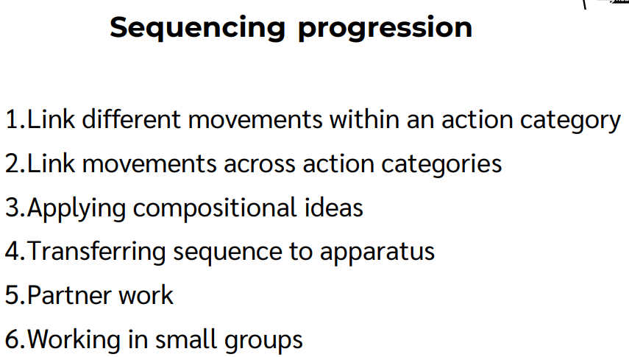
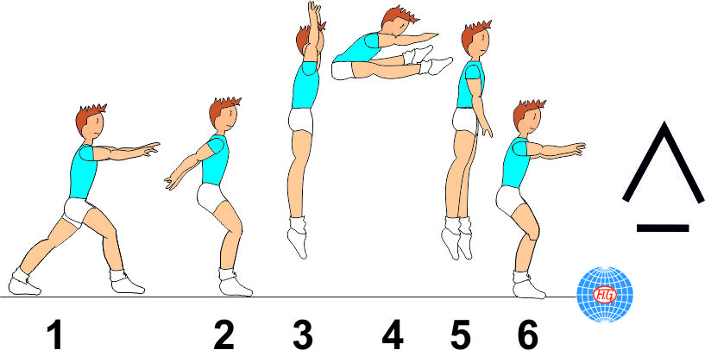
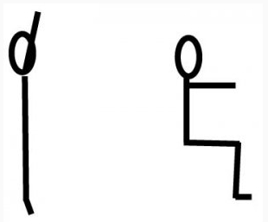
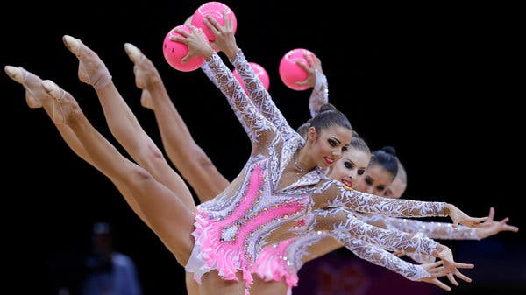
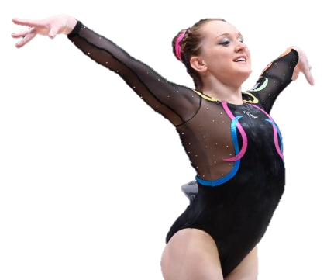
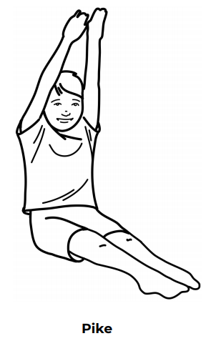
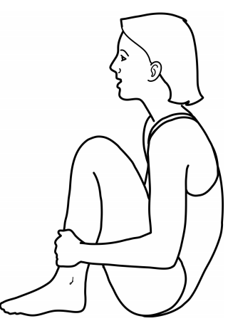
Shirley Heath Year 6, Spring 2: Gymnastics
The various jumps (use apparatus to challenge)
Vocabulary
1 | Fluency | To continue a movement.
2 | Contrasting | Do complete an opposite move.
3 | Unison | Complete a movement in parallel with someone else.
4 | Full turn | Move 360 degrees.
5 | Half-turn | Move 180 degrees.
6 | Control | To influence a certain movement.
7 | Power | The level of force used.
8 | Combinations | Do complete certain routines one after another
9 | Canon | Perform a sequence in unison
10 | Unison | Complete a sequence as the same time as somebody else.
Straddle jump: Jump up to your knees by pushing with you arms. Land on two feet.
Magic Chair Landing:
Jump up high in a stretch jump and land using the magic chair. Use arms to support balance.
<- Start by stretching high.
Landing (knees bent) ->
Cannon: movements introduced by one gymnast are repeated exactly by subsequent gymnasts in turn.
Use a ball, hoop or bean bags to create sequence
Perform this in a Cannon
Amy Tinkler:
Tinkler is a British artistic gymnast who scored a Bronze medal at the 2016 Rio Olympics
Pike
Tuck
Suggested basic skills learnt from Y3/4

