Slide 1
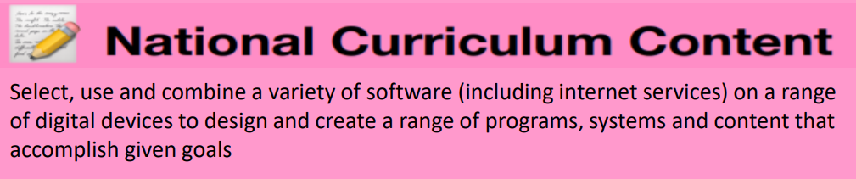


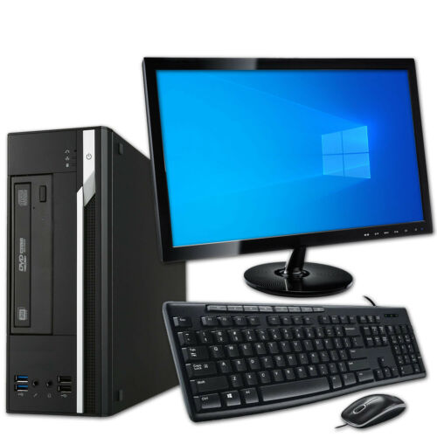




E-Safety
If something upsets you online – tell a teacher or use our report button
Use only your own network details on the computers and ipads – log out when finished!
Never give personal details out online, even if you think you may know the other person
Understand that the school can monitor your computer usage in school including the websites we visit.
Username | Your personalised identification to access a computer
Format | To change the presentation of an item
Word Processor | A software used to create a text document
Wrap text | Change how text is fitting around a selected object (useful when adding images to a document)
When typing, fingers should rest on the home row. Left pointer finger on the ‘F’ and right pointer finger on the ‘J’.
The mouse has two buttons. The left button selects items and double clicks, the right button opens more options.
‘Save’ overrides the original file. ‘Save as’ creates an updated copy – ‘save as’ is what you will normally use in school.
When pasting text or an image look at the paste options: Text will not change. Text will merge to your document layout. (preferred) Only text will paste.
Key Diagram
Computer Tower
Monitor
Ctrl+alt+L | Log off
Ctrl + B | Bold
Ctrl + I | Italics
Ctrl + U | Underline
Ctrl + C | Copy
Ctrl + V | Paste
Keyboard
Mouse

