Slide 1


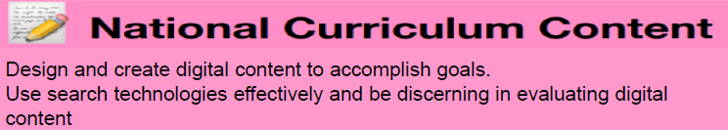
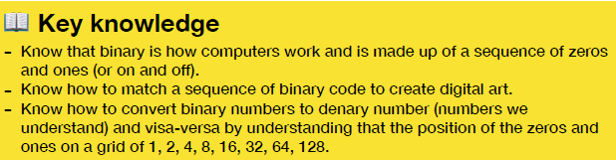
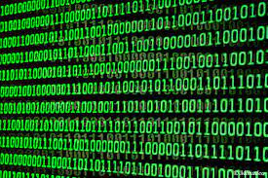

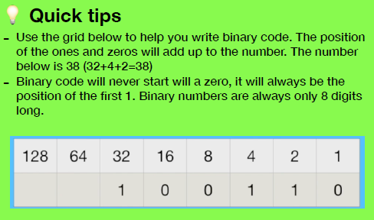
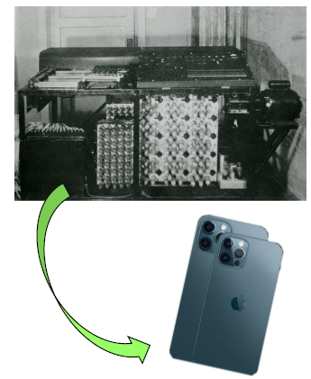
History of Computers and Binary Code Knowledge Organiser
What are we learning with ‘History of Computers’ and ‘Binary Code’?
The History of Computers section of this term’s learning helps us to appreciate the drastic change and predict the future development of computers from 1613 when the word ‘Computer’ was used to describe someone who is perfect at mathematical calculations to today when computers are widely known as the devices which form integral parts of our everyday lives and contribute to progressions in many areas.
The Binary code section helps us to understand the underlying language of a computer which uses a series of zeros and ones that translates to digital data such as the computer processor instructions used everyday.
Important People
Gottfried Leibniz | Invented Binary
Charles Babbage | Designed first computer
Alan Turing | Developed ideas for modern computers
Bill Gates and Paul Allen | Founded Microsoft software
Steve Jobs and Steve Wozniak | Founded Apple

