Slide 1
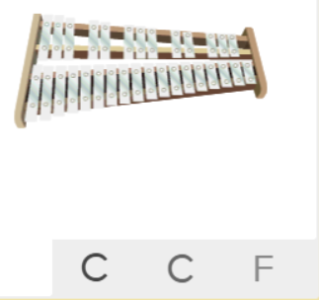
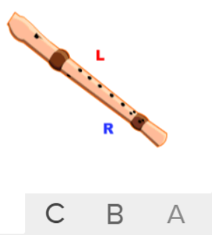
Shirley Heath Let Your Spirit Fly| Year 3 | Term: Autumn 1
About This Unit
Theme: RnB and other musical styles.
Facts/info: RnB is a mixture of Soul, Hip Hop and Gospel music. Other RnB singers include Beyoncé, Usher, Rihanna and Stevie Wonder.
Listen to 4 other songs/pieces: ‘Colonel Bogey March’ by Kenneth Alford (Film) ‘Consider Yourself’ from the musical ‘Oliver!’ (Musicals) ‘Ain’t No Mountain High Enough’ by Marvin Gaye (Motown) ‘You’re The First, The Last, My Everything’ by Barry White (Soul)
Vocabulary
1. | Structure | The arrangement of a song.
2. | INTRODUCTION | A passage or section which opens a movement or a separate piece, preceding the theme or lyrics.
3. | VERSE | When two or more sections of the song have almost identical music but different lyrics.
4. | CHORUS | The chorus is designed to be the most memorable section in a song. It often contains a hook or catchy refrain that a listener can easily remember, drawing them back to any individual track.
5. | Improvise | Playing notes that are not written for you.
6. | Compose | Writing your own music.
7. | Pulse | The regular heartbeat of the music; it’s steady beat.
8. | Rhythm | Long and short sounds or patterns that happen over the pulse.
9. | Pitch | High and low sounds.
10. | Tempo | The speed of the music; fast or slow or in-between.
11. | Dynamics | How loud or quiet the music is.
12. | BASS | The lowest part of the musical scale. It is also a type of guitar which usually has 4-5 strings.
13. | DRUMS | A drum is a musical instrument that you play by hitting it rhythmically with a stick or your hand.
14. | GUITAR | A flat-bodied stringed instrument with a long fretted neck and usually six strings played with a pick or with the fingers.
15. | KEYBOARD | A musical keyboard is the set of adjacent depressible levers or keys on a musical instrument.
16. | SYNTHESIZER | A synthesizer is an electronic instrument that generates a wide range of sounds using an electrical signal.
17. | HOOK | A catchy combination of melody, lyrics and rhythm that stays in the listener's head
18. | Melody | The tune.
Listen and Appraise: Let Your Spirit Fly (RnB)
Structure: Introduction, verse, chorus.
Instruments/voices you can hear: Male and female voices, bass, drums, guitar, keyboard, synthesizer.
Find the pulse as you are listening: Dance, clap, sway, march, be an animal or a pop star.
Musical Activities (Using glocks / recorders)

