Slide 1
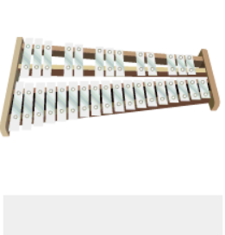
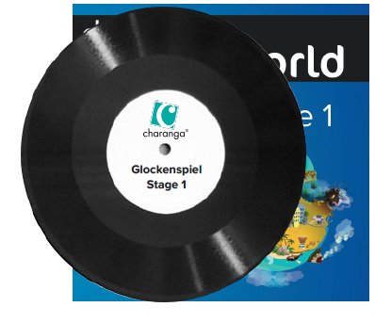
Shirley Heath Glockenspiel Stage 1| Year 3 | Term: Autumn 2
About This Unit
Theme: Exploring and developing playing skills using the glockenspiel.
Vocabulary
1. | Improvise | Playing notes that are not written for you.
2. | Compose | Writing your own music.
3. | Pulse | The regular heartbeat of the music; it’s steady beat.
4. | Rhythm | Long and short sounds or patterns that happen over the pulse.
5. | Pitch | High and low sounds.
6. | Tempo | The speed of the music; fast or slow or in-between.
7. | Texture | Layers of sound. Layers of sound working together make music interesting to listen to.
8. | Structure | Every piece has a structure e.g. an introduction, verse, chorus and ending.
9. | MELODY | The tune.
10. | STAVE | The 5 horizontal ladder lines that all notes sit on.
11. | TREBLE CLEF | A symbol which shows the notes on the stave are above middle C
12. | Time signature | Explains the number and types of notes within each bar.
13. | BAR | A small section of music that contains a number of beats.
14. | BAR LINE | Divides each bar up.
15. | CROTCHET | A musical note with a value of one count.
16. | MINIM | A musical note with a value of two counts.
17. | SEMIBREVE | A musical note with a value of four counts.
18. | CROTCHET REST | A musical silence with a value of one count.
19. | MINIM REST | A musical silence with a value of two counts.
20. | SEMIBREVE REST | A musical silence with a value of four counts.
Musical Activities (Using glocks)
Learn to play these tunes: Easy E Strictly D Play Your Music Drive Dee Cee’s Blues What’s Up D-E-F-initely Roundabout March of the Golden Guards Portsmouth
Improvise with Dee Cee’s Blues using the notes C + D.
Compose using the notes C, D, E + F.
C D E F

