Slide 1
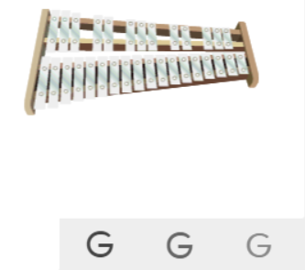
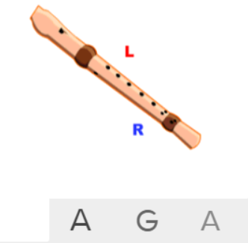
Shirley Heath Mamma Mia| Year 4 | Term: Autumn 1
About This Unit
Theme: ABBA’s music.
Facts/info: ABBA was a Swedish pop group formed in 1972.
Listen to 4 other ABBA songs/pieces: ‘Mamma Mia’ ‘Dancing Queen’ ‘The Winner Takes It All’ ‘Waterloo’ ‘Super Trouper’ ‘Thank You For The Music’
Vocabulary
1. | KEYBOARD | A musical keyboard is the set of adjacent depressible levers or keys on a musical instrument.
2. | ELECTRIC GUITAR | A guitar that produces sound by vibrating strings over a pickup that converts the vibrations into electrical signals.
3. | BASS | The lowest part of the musical scale. It is also a type of guitar which usually has 4-5 strings.
4. | DRUMS | A drum is a musical instrument that you play by hitting it rhythmically with a stick or your hand.
5. | Improvise | Playing notes that are not written for you.
6. | Compose | Writing your own music.
7. | Melody | The tune.
8. | Pulse | The regular heartbeat of the music; it’s steady beat.
9. | Rhythm | Long and short sounds or patterns that happen over the pulse.
10. | Pitch | High and low sounds.
11. | Dynamics | How loud or quiet the music is.
12. | TEXTURE | How the tempo, melodic, and harmonic materials are combined in a musical composition, determining the overall quality of the sound in a piece.
13. | Structure | The arrangement of a song.
14. | HOOK | A catchy combination of melody, lyrics and rhythm that stays in the listener's head
15. | RIFF | An ostinato; a repeated chord progression, pattern, or melody, often played by rhythmic instruments.
16. | SOLO | A piece or a section of a piece that is played or sung by a single performer.
17. | PENTATONIC SCALE | A musical scale containing five different tones.
18. | UNISON | Two or more voices or instruments playing the same note simultaneously.
Listen and Appraise: Mamma Mia (Pop)
Structure: Intro, verse, bridge, chorus, introduction, verse, bridge, chorus.
Instruments/voices you can hear: Keyboard sounds imitating strings, a glockenspiel playing as a keyboard, electric guitar, bass, drums.
Find the pulse as you are listening.
Musical Activities (Using glocks / recorders)

