Slide 1
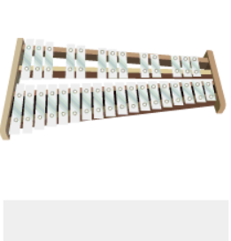
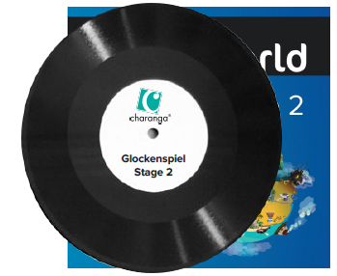
Shirley Heath Glockenspiel Stage 2| Year 4 | Term: Autumn 2
About This Unit
Theme: Exploring and developing playing skills using the glockenspiel.
Vocabulary
1. | RHYTHM PATTERNS | Are repeated throughout the music (as in “feel the rhythm”).
2. | Compose | Writing your own music.
3. | Melody | The tune.
4. | Pulse | The regular heartbeat of the music; it’s steady beat.
5. | Rhythm | Long and short sounds or patterns that happen over the pulse.
6. | Pitch | High and low sounds.
7. | Tempo | The speed of the music; fast or slow or in-between.
8. | Dynamics | How loud or quiet the music is.
9. | TEXTURE STRUCTURE | How layers of sound within a piece of music interact.
10. | STAVE | The 5 horizontal ladder lines that all notes sit on.
11. | TREBLE CLEF | A symbol which shows the notes on the stave are above middle C
12. | Time signature | Explains the number and types of notes within each bar.
13. | BAR | A small section of music that contains a number of beats.
14. | BAR LINE | Divides each bar up.
15. | STAVE | The 5 horizontal ladder lines that all notes sit on.
16. | MINIM | A musical note with a value of two counts.
17. | SEMIBREVE | A musical note with a value of four counts.
18. | CROTCHET REST | A musical silence with a value of one count.
19. | MINIM REST | A musical silence with a value of two counts.
20. | SEMIBREVE REST | A musical silence with a value of four counts.
Musical Activities (Using glocks)
Learn to play these tunes: ● Mardi Gras Groovin’ ● Two-Way Radio ● Flea Fly ● Rigadoon ● Mamma Mia
Revisit these tunes from Stage 1: ● Portsmouth ● Strictly D ● Play Your Music ● Drive
Compose using the notes C, D, E, F + G.
C D E F G

