Slide 1
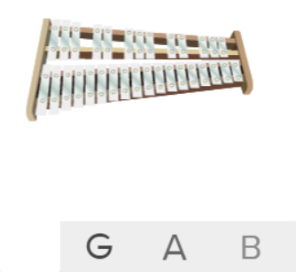
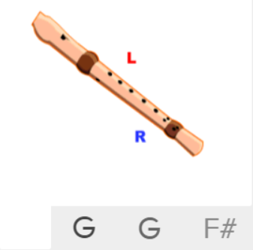
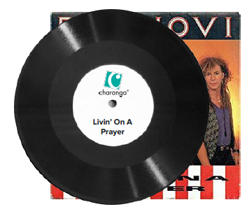
Shirley Heath Livin’ On A Prayer| Year 5 | Term: Autumn 1
About This Unit
Theme: Rock anthems.
Facts/info: ‘Livin’ on a Prayer’ is a Rock song that was released in 1986. The words tell us about life in the 1980’s.
Listen to 5 other rock songs: ‘We Will Rock You’ by Queen ‘Smoke On The Water’ by Deep Purple ‘Rockin’ All Over The World’ by Status Quo ‘Johnny B. Goode’ by Chuck Berry ‘I Saw Her Standing There’ by The Beatles
Vocabulary
1. | ROCK | A form of popular music that emerged in the 1950s and is defined as “a form of music with a strong beat.”
2. | Structure | The arrangement of a song.
3. | Pulse | The regular heartbeat of the music; it’s steady beat.
4. | Rhythm | Long and short sounds or patterns that happen over the pulse.
5. | Pitch | High and low sounds.
6. | BRIDGE | Contrasting section which leads back to the main material.
7. | BACKBEAT | A steady pronounced rhythm stressing the second and fourth beats of a four-beat measure.
8. | AMPLIFIER | A device that makes an electronic signal stronger, and it's most often used to increase the volume of musical instruments.
9. | Tempo | The speed of the music; fast or slow or in-between.
10. | TEXTURE | Layers of sound. Layers of sound working together to make music interesting to listen to.
11. | Dynamics | How loud or quiet the music is.
12. | CHORUS | The chorus is designed to be the most memorable section in a song. It often contains a hook or catchy refrain that a listener can easily remember, drawing them back to any individual track.
13. | BRIDGE
14. | RIFF | An ostinato; a repeated chord progression, pattern, or melody, often played by rhythmic instruments.
15. | HOOK | A catchy combination of melody, lyrics and rhythm that stays in the listener's head
16. | Improvise | Playing notes that are not written for you.
17. | Compose | Writing your own music.
Listen and Appraise: Livin’ On A Prayer (Rock)
Structure: Intro, verse 1, bridge, chorus, intro, verse 2, bridge, chorus, guitar solo, bridge, chorus.
Instruments/voices you can hear: Lead vocal, electric guitar, bass guitar, drums, keyboard.
Can you find the pulse as you are listening? Is the tempo fast, slow or in-between? Dynamics? Texture?
Musical Activities (Using glocks / recorders)

