Slide 1
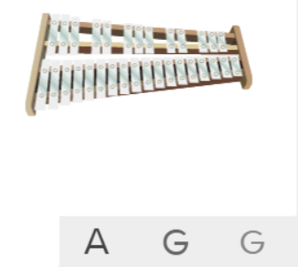
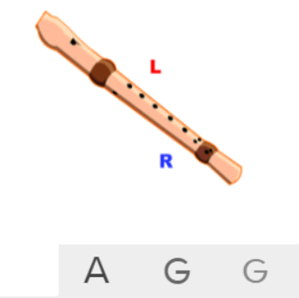
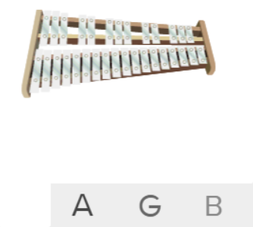
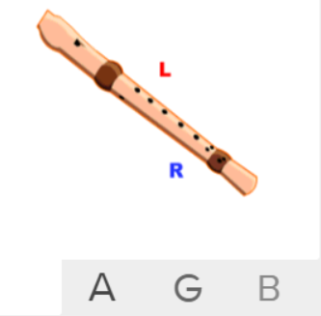
Shirley Heath Happy| Year 6 | Term: Autumn 1
About This Unit
Theme: Being Happy!
Facts/info: Happy is a song written, produced and performed by Pharrell Williams. Happy is a Pop song that has a soul music sound and groove from the 1960s; very much like a Motown song.
Listen to 5 other songs in different styles. What are their styles?: ‘Top Of The World’ sung by The Carpenters ‘Don’t Worry, Be Happy’ sung by Bobby McFerrin ‘Walking On Sunshine’ sung by Katrina And The Waves ‘When You’re Smiling’ sung by Frank Sinatra ‘Love Will Save The Day’ sung by Brendan Reilly
Vocabulary
1. | MELODY | The tune.
2. | Compose | Writing your own music.
3. | Improvise | Playing notes that are not written for you.
4. | COVER | A new performance or recording by a musician other than the original performer or composer of the song.
5. | Pulse | The regular heartbeat of the music; it’s steady beat.
6. | Rhythm | Long and short sounds or patterns that happen over the pulse.
7. | Pitch | High and low sounds.
8. | Tempo | The speed of the music; fast or slow or in-between.
9. | Dynamics | How loud or quiet the music is.
10. | TIMBRE | The distinguishing characteristic that differentiates one sound from another, despite the fact that they might be playing the same frequency with the same amplitude.
11. | TEXTURE | Layers of sound. Layers of sound working together to make music interesting to listen to.
12. | STRUCTURE | The order that different parts of the song are played in.
13. | NEO SOUL | The style emerged from Soul and contemporary RnB. The instrumentation, arrangement and studio mix are very important. Songs are mixed in the studio to sound as if they are from an older Soul era like the Motown era. The modern way in which the songs are produced, give a timeless Soul feel that has a contemporary edge.
14. | GROOVE | The rhythmic part of the music that makes you want to move and dance.
15. | MOTOWN | A 1960s label created from Soul music characterised by a rhythm section playing, laying down the groove with a funky bassline and a tambourine sounding over the top. Often brass sections play punchy riff-based rhythms and sometimes violins playing long high notes.
16. | BRIDGE | Contrasting section which leads back to the main material.
17. | HOOK | A catchy combination of melody, lyrics and rhythm that stays in the listener's head
18. | RIFF | An ostinato; a repeated chord progression, pattern, or melody, often played by rhythmic instruments.
19. | SOLO | A piece or a section of a piece that is played or sung by a single performer.
Listen and Appraise: Happy (Pop / Neo Soul)
What style indicators can you hear?
Describe the structure?
What instruments/voices you can hear?
Describe the musical dimensions?
Musical Activities (Using glocks / recorders)
Easy part
Easy part
Medium part
Medium part

