Slide 1
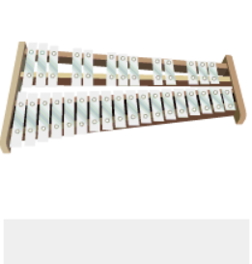
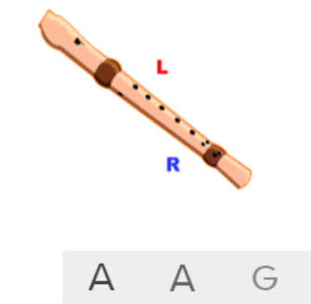
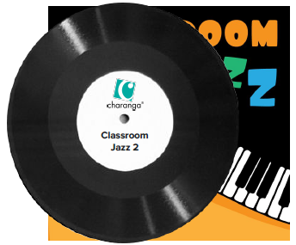
Shirley Heath Classroom Jazz 2| Year 6 | Term: Autumn 2
About This Unit
Themes: Jazz, improvisation and composition.
Facts/info: Bacharach Anorak has a Latin American groove. Blues is a style of music originating in the deep south of America and is considered an ancestor of Jazz.
Listen to 4 other pieces of music: ‘Take The ‘A’ Train’ by Duke Ellington ‘Speaking My Peace’ by H. Parlan ‘Back ‘O’Town Blues’ by Earl Hines ‘One ‘O’ Clock Jump’ by Count Basie
Vocabulary
1. | BLUES | A style of music characterised by its harmonic structure and the notes used to create the melodies.
2. | JAZZ | A music genre that originated in the African-American communities of New Orleans, United States, in the late 19th and early 20th centuries, and developed from roots in blues and ragtime.
 | MELODY | The tune.
 | Compose | Writing your own music.
 | Improvise | Playing notes that are not written for you.
 | Pulse | The regular heartbeat of the music; it’s steady beat.
3. | Rhythm | Long and short sounds or patterns that happen over the pulse.
4. | Pitch | High and low sounds.
5. | Tempo | The speed of the music; fast or slow or in-between.
6. | Dynamics | How loud or quiet the music is.
7. | TIMBRE | The distinguishing characteristic that differentiates one sound from another, despite the fact that they might be playing the same frequency with the same amplitude.
8. | TEXTURE | Layers of sound. Layers of sound working together to make music interesting to listen to.
 | STRUCTURE | How the sections (verses and choruses etc.) of a song are ordered to make the whole piece.
9. | BRIDGE | Contrasting section which leads back to the main material.
10. | HOOK | A catchy combination of melody, lyrics and rhythm that stays in the listener's head
11. | RIFF | An ostinato; a repeated chord progression, pattern, or melody, often played by rhythmic instruments.
12. | SOLO | A piece or a section of a piece that is played or sung by a single performer.
Listen and Appraise: ‘Bacharach Anorak’ and ‘Meet The Blues’
What style indicators can you hear?
Describe the structure?
What instruments/voices you can hear?
Describe the musical dimensions?
Musical Activities (Using glocks / recorders)
C D E F G A B
C D E F G A B

