Slide 1
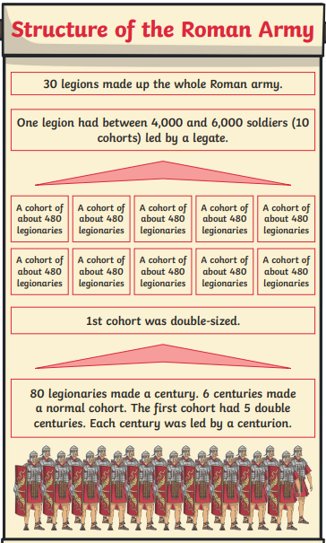
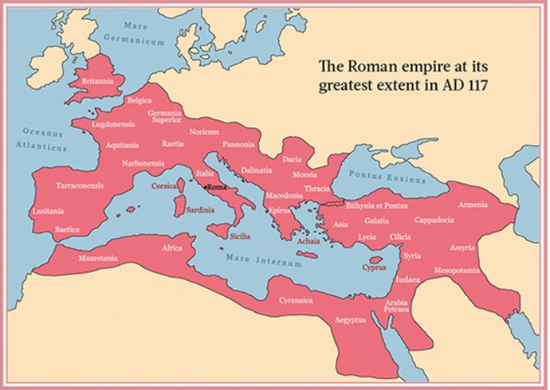
Shirley Heath The Romans| Year 4 | Autumn 1
Key Facts
The Roman Empire started in 27BC. The Roman empire was ruled by emperors. The fall of Roman Empire was in 476 AD.
The Romans would have many past times and would visit the baths and amphitheatres Gladiators were a key part of entertainment There are many primary sources from the Roman Empire
The Roman army were so important because they helped to establish the empire. The Roman army was made up of legions. The Roman army was very successful as it was large, well-organised and the soldiers were well-trained.
Led by emperor Claudius, the Romans invaded Britain in 43 AD, which was the end of the Iron Age. Hadrian’s Wall was built to help the Romans control their borders in Britain. When the Romans invaded Britain they introduced many things including roads, sewage systems and brick buildings.
Some Celts did try to resist the Roman rule. Boudicca was the leader of the Iceni tribe. Boudicca tried to overthrow the Romans rule and lost.
Vocabulary
Emperors | Based in Rome in Italy, ruled over land that stretched far beyond the borders. Era began in 27 BC.
Empire | A group of countries that are controlled by one ruler.
Public baths | Designed for bathing and relaxing, they were a common feature of cities throughout the Roman empire.
Amphitheatre | An oval or round building with seats rising in rows from an open, central area, used for sports and other public events.
Gladiators | Professional warriors who fought each other to entertain an audience.
Auxiliary troops | Non-Roman citizens who fought alongside soldiers in the legions.
Invasion | Armed forces from one area entering territory of another area, often resulting in the occupation of the area
Centurion | A kind of soldier in the Roman army responsible for the command of a century, or one hundred, men.
Legion | A group from 3000 to 6000 soldiers that made up the chief army unit in ancient Rome.
Legionary | A professional soldier of the Roman army
Uprising | Rebelling or rising up against an authority – fighting against authority.

