Slide 1
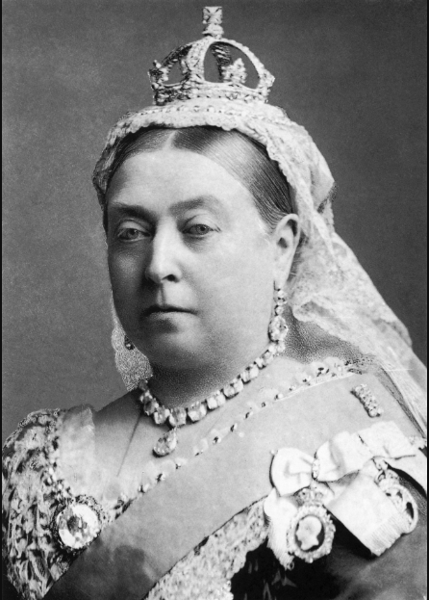
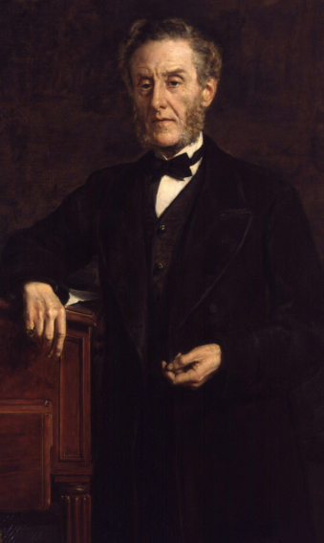
Shirley Heath Victorians | Year 5 | Autumn 1
Key Knowledge
Queen Victoria ruled the United Kingdom between 1837 and 1901 Queen Victoria helped to grow the British Empire. The Victorian Era was seen as a period of change.
The Industrial Revolution was the period when Britain changed from being a mainly agricultural country to being an industrial one. The Industrial Revolution was positive because it developed the use of factories, machinery and steam in manufacturing. The Industrial Revolution was negative as the conditions of factories were very poor and dangerous, especially for child workers.
During the Victorian era, there were many inventions which are still used today e.g. the telephone, the car, the London Underground Railway.
People moved from the country to large cities for jobs. There was an increase in illness and dirt as there were lots of people living in the same buildings. Moving to the cities meant people could find more work.
Children were expected to work in dangerous conditions for long hours. A mine collapsing lead to Lord Shaftesbury wanting to change laws for children. Lord Shaftesbury created social reforms to improve the lives of children.
Vocabulary
Queen Victoria | A former Queen of the United Kingdom
Prince Albert | Queen Victoria’s husband
Industrial Revolution | A a time when the manufacturing of goods moved from small shops and homes to large factories.
Agriculture | Farming
Manufacturing | The making of products by hand or machinery.
Industrialisation | When machinery is used for large scale manufacturing, rather than humans
Urbanisation | An increase in the proportion of people living in urban areas compared to rural areas
Migration | The movement of people from one place to another
Population | The number of people living in one place
Social reforms | Changes and improvements to a law, social system, or institution
Lord Shaftesbury | A leading advocate of improving children's life in Britain.
Mines | A place where deep holes and tunnels are dug under the ground in order to obtain a mineral such as coal, diamonds, or gold
Queen Victoria
Lord Shaftesbury

