Slide 1
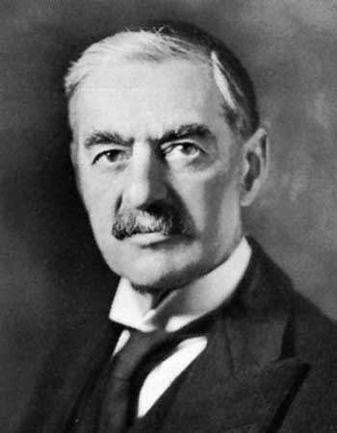
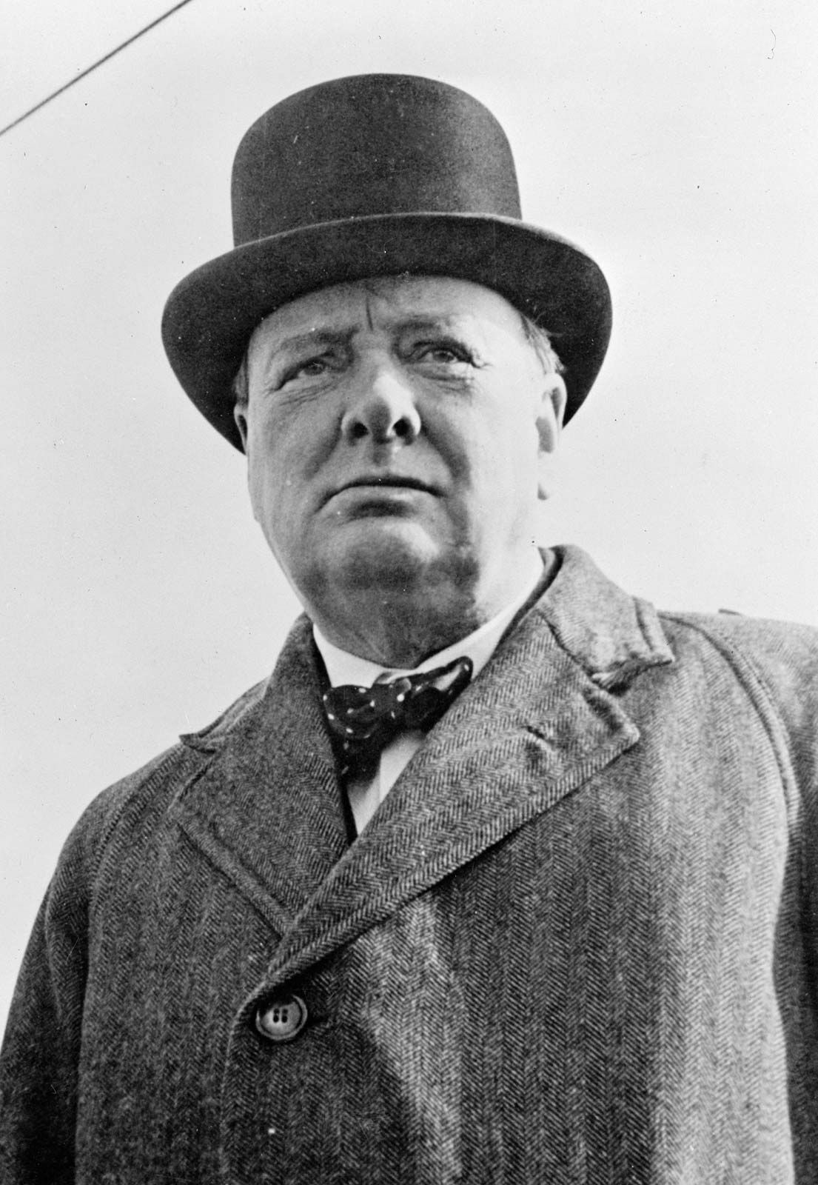
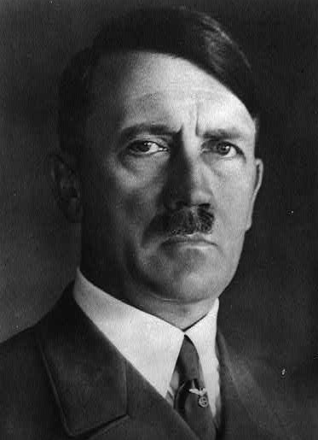
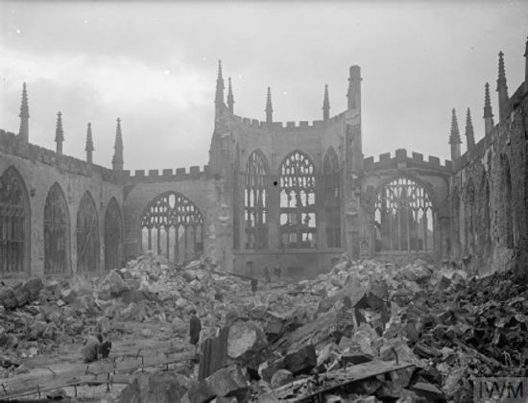
Shirley Heath A Local Study – World War 2| Year 6 | Autumn 1
Key People
Adolf Hitler | The leader of Germany from 1933 to 1945. He was the leader of the Nazi party and became a powerful dictator
Neville Chamberlain | The Prime Minister of the UK from 1937 to 1940.
Winston Churchill | The Prime Minister of the UK from 1940 to 1945.
Vocabulary
Nazi | Member of a political group called the National Socialist German Workers’ Party that ruled Germany between 1933 and 1945
The Allies | One side that fought the war - the Allied Forces (or Allies) included Great Britain, France, The Soviet Union, China and The United States of America
The Axis Powers | The other side that fought the war – Germany, Italy and Japan
Air raid | The enemy attacks from the Luftwaffe (the German air force).
The Blitz | The night bombing raids that Germany launched against Britain in 1940.
Blackouts | Windows and doors were covered at night and sources of light were shielded – started in 1939
Rationing | Certain were restricted - people could only buy a limited amount.
Evacuation | Many children, pregnant women and other vulnerable people were moved from big cities to the countryside.
Conscription | Most males aged between 18 and 41 were forced to join the armed forces.
Holocaust | When millions of Jews and other groups were killed by the Nazis between 1941 and 1945.
VE Day | Victory in Europe Day. It marks the end of World War II in Europe on 8th May 1945, when the Nazi forces officially surrendered to the Allies.
Key Facts
The war started when Britain declared war on 3rd September 1939 after Hitler invaded Poland. Neville Chamberlain was Prime Minister when war was declared and Winston Churchill took over. Hitler was the leader of Germany during World War 2
Hitler bombed Britain to destroy morale and the ammunition factories. Coventry and Birmingham were targeted as they were major areas for war production. Coventry Cathedral was bombed during the Blitz.
During World War 2, there were many changes in Coventry and Britain Women started doing men’s jobs, food was rationed and vulnerable people were evacuated.
There were many similarities between Germany and Coventry during World War 2 including rationing, evacuation and bombing raids. The main difference between Germany and Coventry was the treatment of certain people – The Holocaust. Some children’s experiences in Coventry was very different to countries under Germany’s rule – Anne Frank.
World War 2 ended in Europe on 8th May 1945 (VE Day) when Germany surrendered. Life changed after World War 2 as women went back to the roles they had before the war. Life continued to be similar after World War 2 as rationing was still in place. Technology (including tanks, radars and aircrafts) had been improved during the war which meant they were more effective following the war.
Neville Chamberlain
Winston Churchill
Adolf
Hitler
Coventry Cathedral during the Blitz

